Slide 2
Most Enzymes are Proteins
Cofactor
Coenzyme
Prosthetic group
Holoenzyme
Apoenzyme
Apoprotein

Slide 3
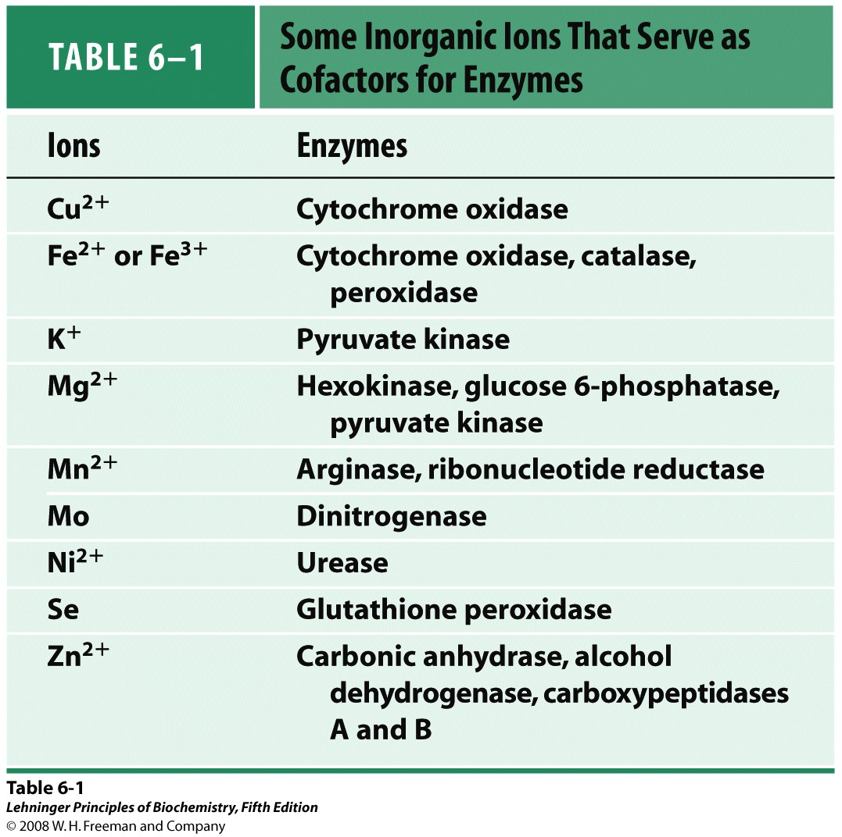

Slide 4
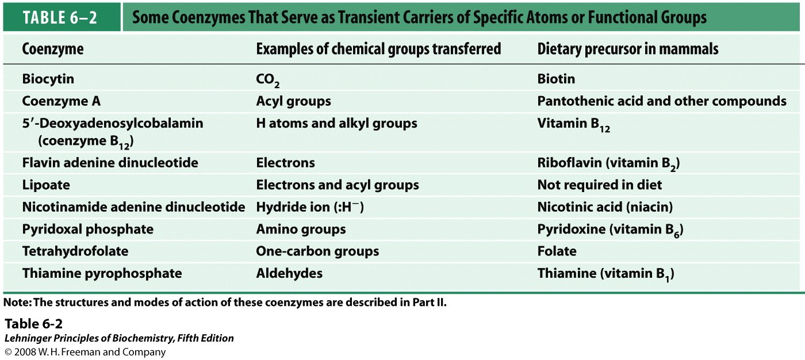

Slide 5
Nomenclature
Remember the five basic reactions in biochemistry

Slide 6
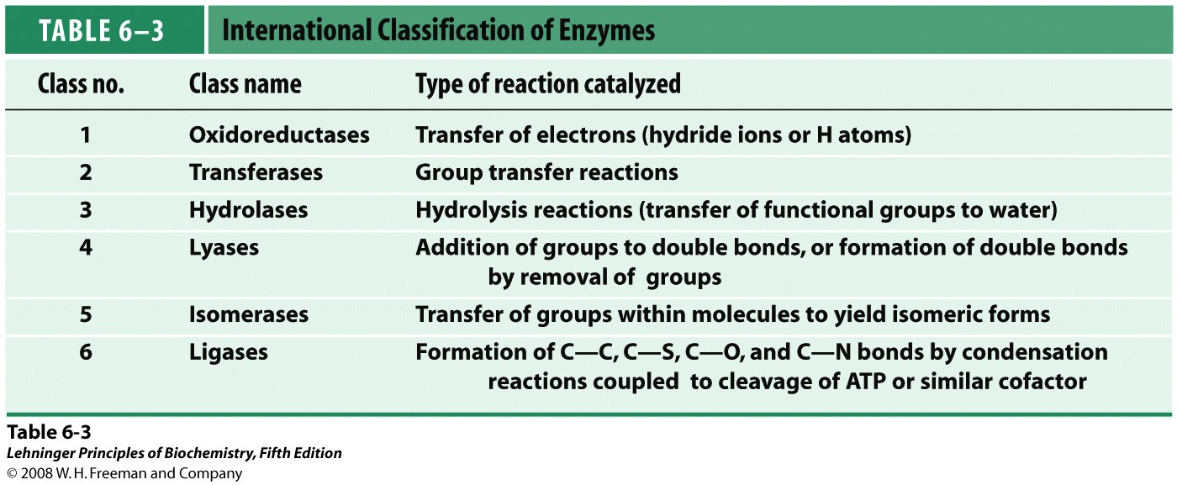

Slide 17
EC 1.1.1.1
Common name: alcohol dehydrogenase
Reaction: an alcohol + NAD⁺ = an aldehyde or ketone + NADH + H⁺
Other name(s): aldehyde reductase; ADH; alcohol dehydrogenase (NAD); aliphatic alcohol dehydrogenase; ethanol dehydrogenase; NAD-dependent alcohol dehydrogenase; NAD-specific aromatic alcohol dehydrogenase; NADH-alcohol dehydrogenase; NADH-aldehyde dehydrogenase; primary alcohol dehydrogenase; yeast alcohol dehydrogenase
Systematic name: alcohol:NAD⁺ oxidoreductase
Comments: A zinc protein. Acts on primary or secondary alcohols or hemi-acetals; the animal, but not the yeast, enzyme acts also on cyclic secondary alcohols.
CAS registry number: 9031-72-5
References:
1. Brändén, G.-I., Jörnvall, H., Eklund, H. and Furugren, B. Alcohol dehydrogenase. In: Boyer, P.D. (Ed.), The Enzymes, 3rd ed., vol. 11, Academic Press, New York, 1975, p. 103-190.
2. Jörnvall, H. Differences between alcohol dehydrogenases. Structural properties and evolutionary aspects. Eur. J. Biochem. 72 (1977) 443-452. [Medline UI: 77115786]
3. Negelein, E. and Wulff, H.-J. Diphosphopyridinproteid ackohol, acetaldehyd. Biochem. Z. 293 (1937) 351-389.
4. Sund, H. and Theorell, H. Alcohol dehydrogenase. In: Boyer, P.D., Lardy, H. and Myrbäck, K. (Eds.), The Enzymes, 2nd ed., vol. 7, Academic Press, New York, 1963, p. 25-83.
5. Theorell, H. Kinetics and equilibria in the liver alcohol dehydrogenase system. Adv. Enzymol. Relat. Subj. Biochem. 20 (1958) 31-49.
[EC 1.1.1.1 created 1961]

Slide 18
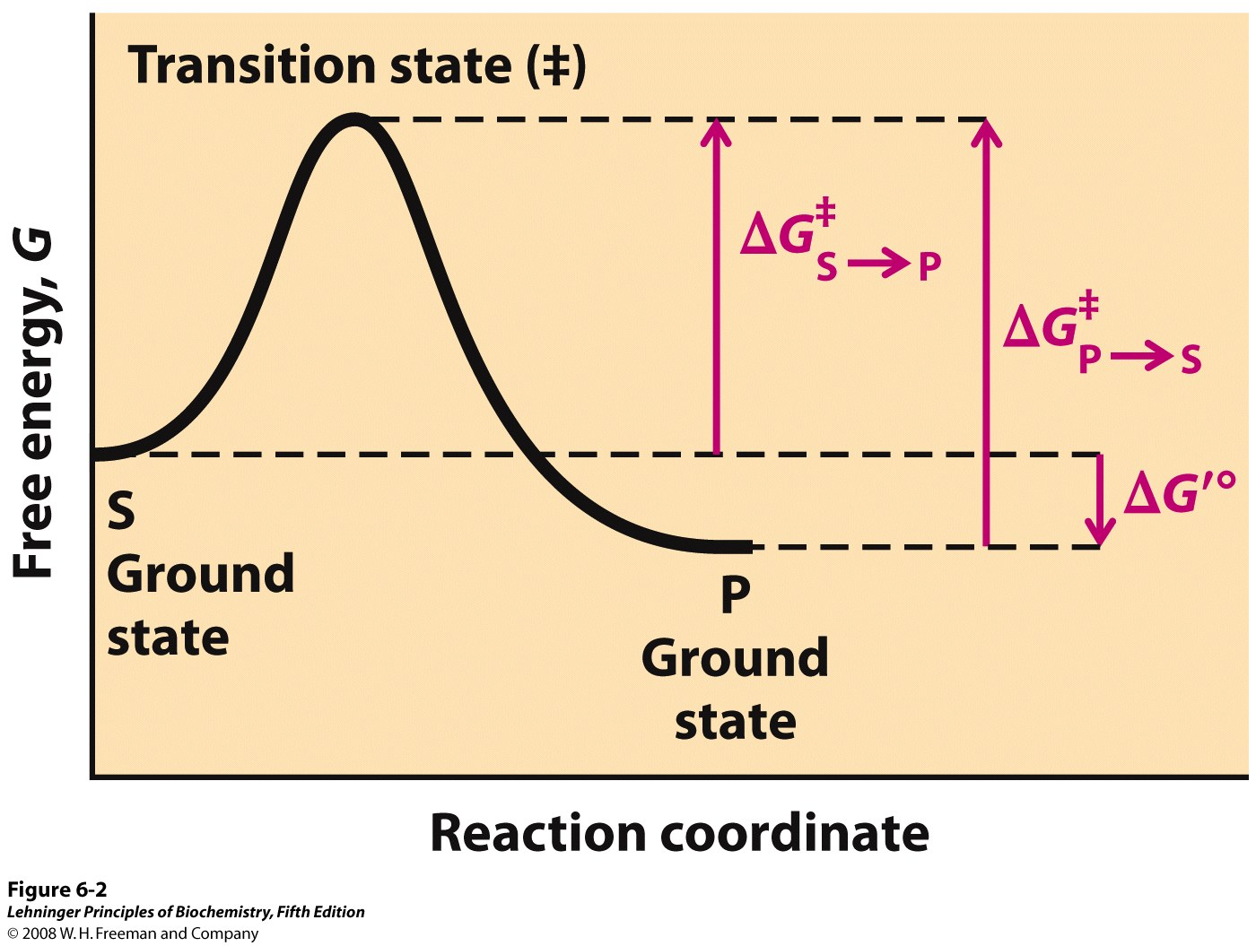
Notes:
FIGURE 6-2 Reaction coordinate diagram. The free energy of the system is plotted against the progress of the reaction S → P. A diagram of this kind is a description of the energy changes during the reaction, and the horizontal axis (reaction coordinate) reflects the progressive chemical changes (e.g., bond breakage or formation) as S is converted to P. The activation energies, ΔG˚, for the S → P and P → S reactions are indicated. ΔG′˚ is the overall standard free-energy change in the direction S → P.

Slide 19
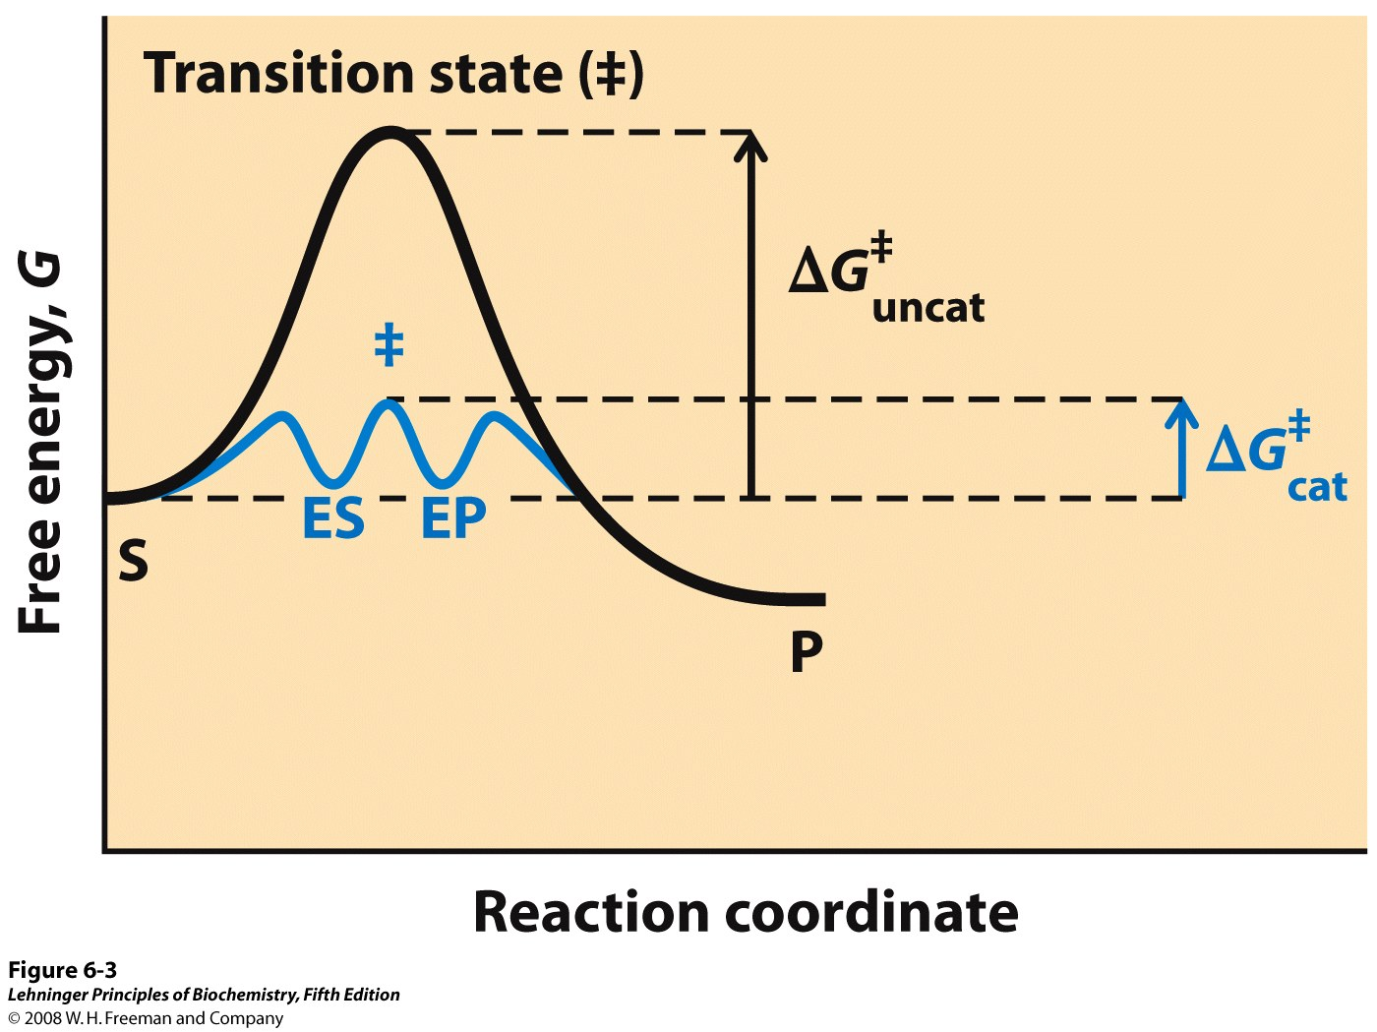
Notes:
FIGURE 6-3 Reaction coordinate diagram comparing enzyme-catalyzed and uncatalyzed reactions. In the reaction S → P, the ES and EP intermediates occupy minima in the energy progress curve of the enzyme-catalyzed reaction. The terms ΔG‡_{uncat} and ΔG‡_{cat} correspond to the activation energy for the uncatalyzed reaction and the overall activation energy for the catalyzed reaction, respectively. The activation energy is lower when the enzyme catalyzes the reaction.

Slide 20
Ground state
Standard free-energy change
Biochemical standard free-energy change
Transition state
Activation energy
Reaction intermediate
Rate-limiting step
Rate-determining step
Equilibrium constant
Rate constant
Rate equation
Binding energy

Slide 21
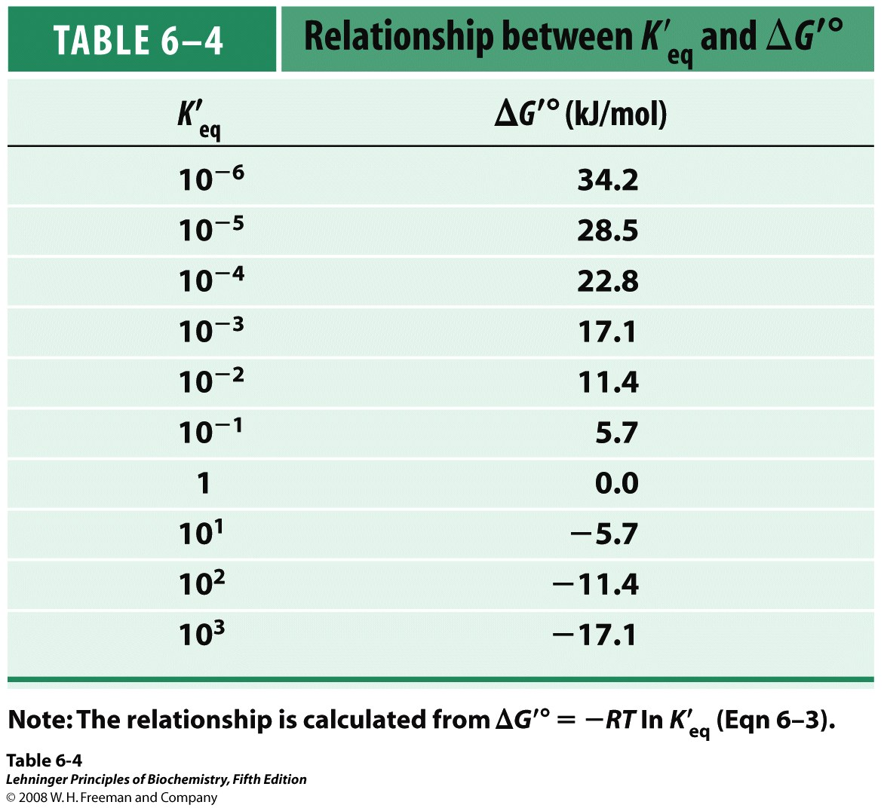

Slide 22
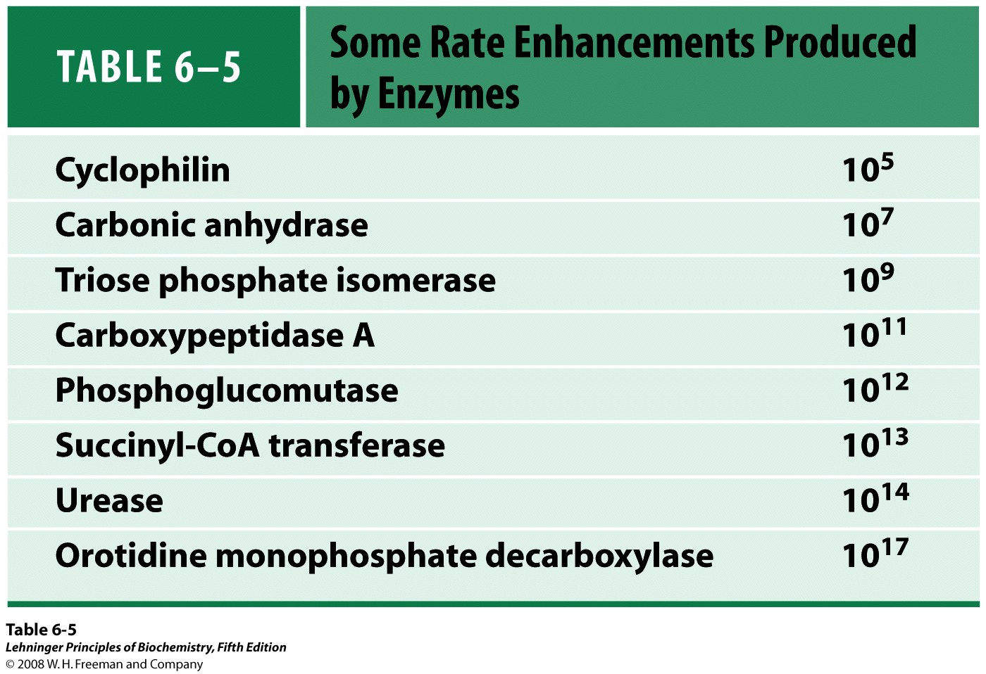

Slide 23
Weak interactions optimized in the
transition state

Slide 24
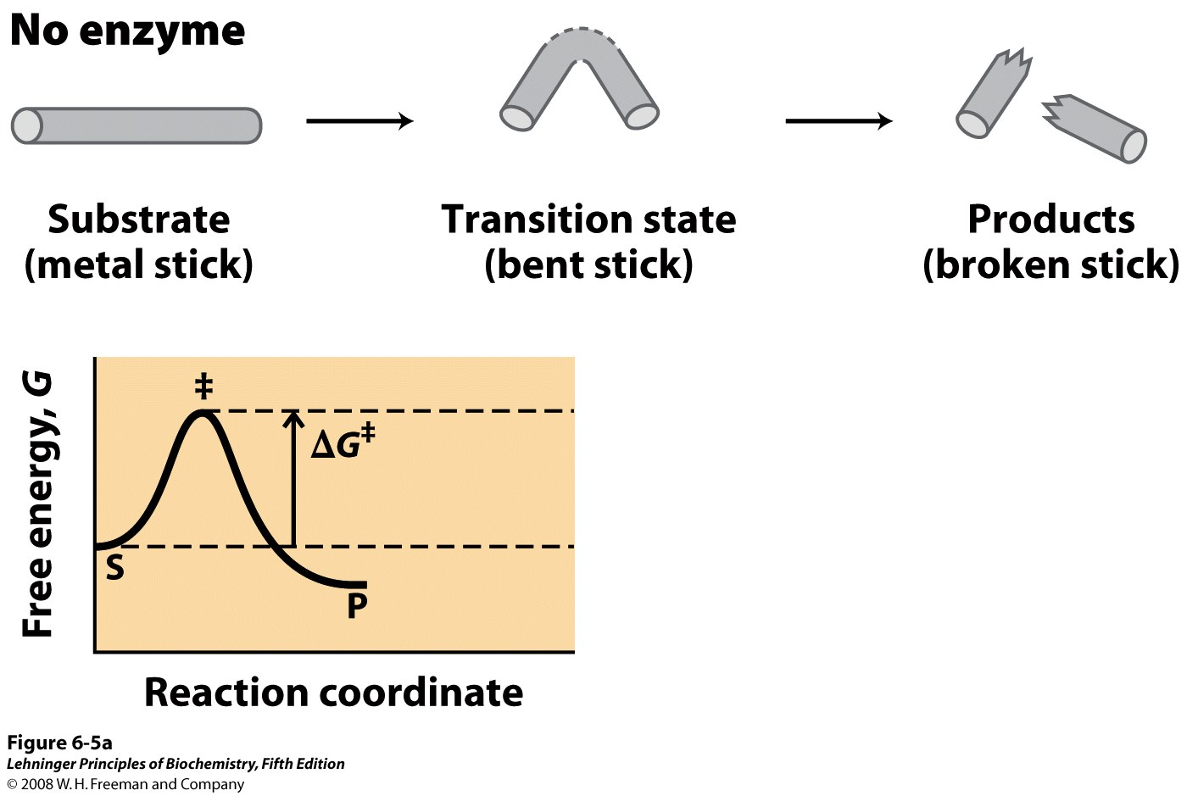
Notes:
FIGURE 6-5a An imaginary enzyme (stickase) designed to catalyze breakage of a metal stick. (a) Before the stick is broken, it must first be bent (the transition state). In both stickase examples, magnetic interactions take the place of weak bonding interactions between enzyme and substrate.

Slide 25
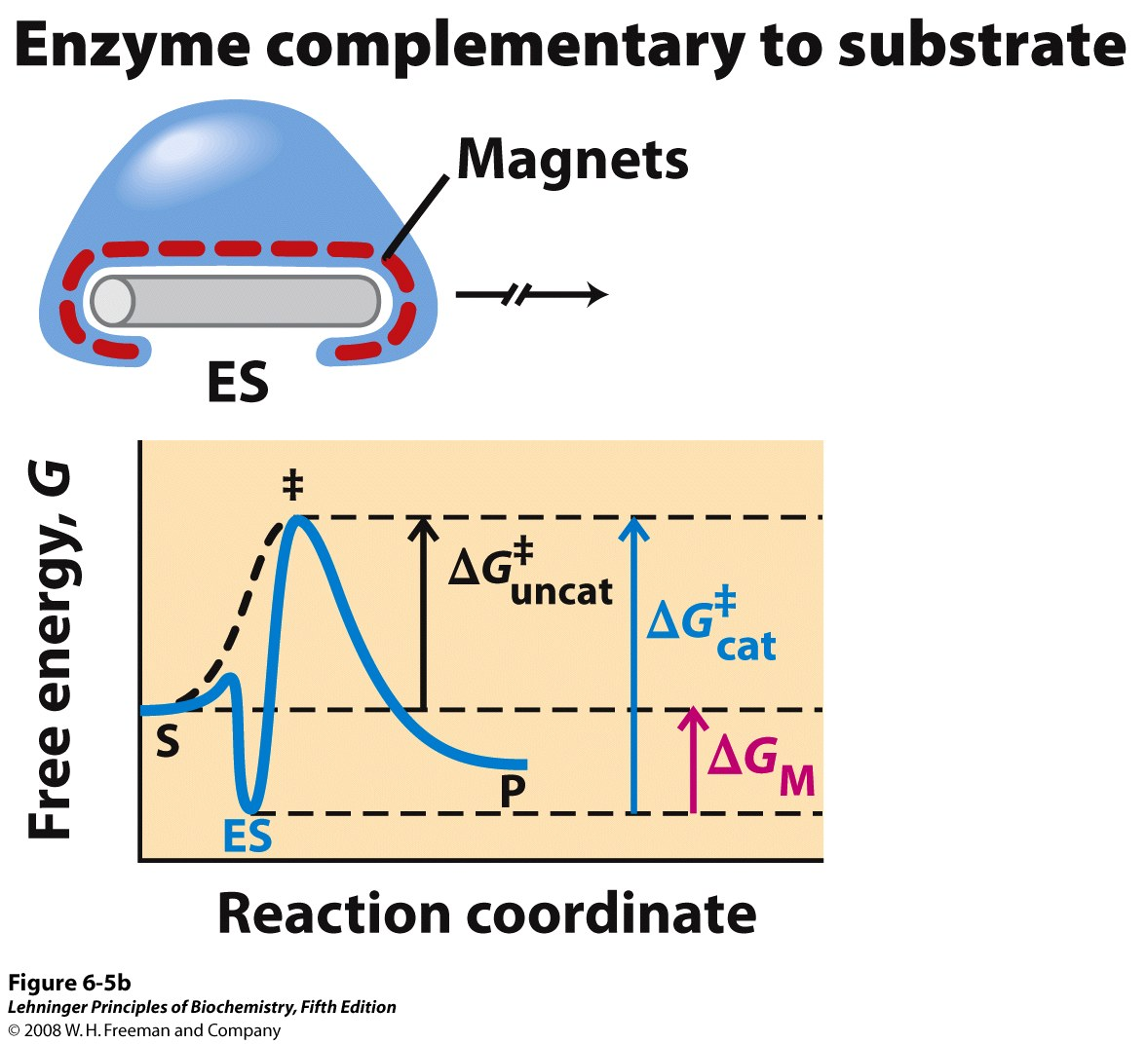
Notes:
FIGURE 6-5b An imaginary enzyme (stickase) designed to catalyze breakage of a metal stick. (b) A stickase with a magnet-lined pocket complementary in structure to the stick (the substrate) stabilizes the substrate. Bending is impeded by the magnetic attraction between stick and stickase.

Slide 26
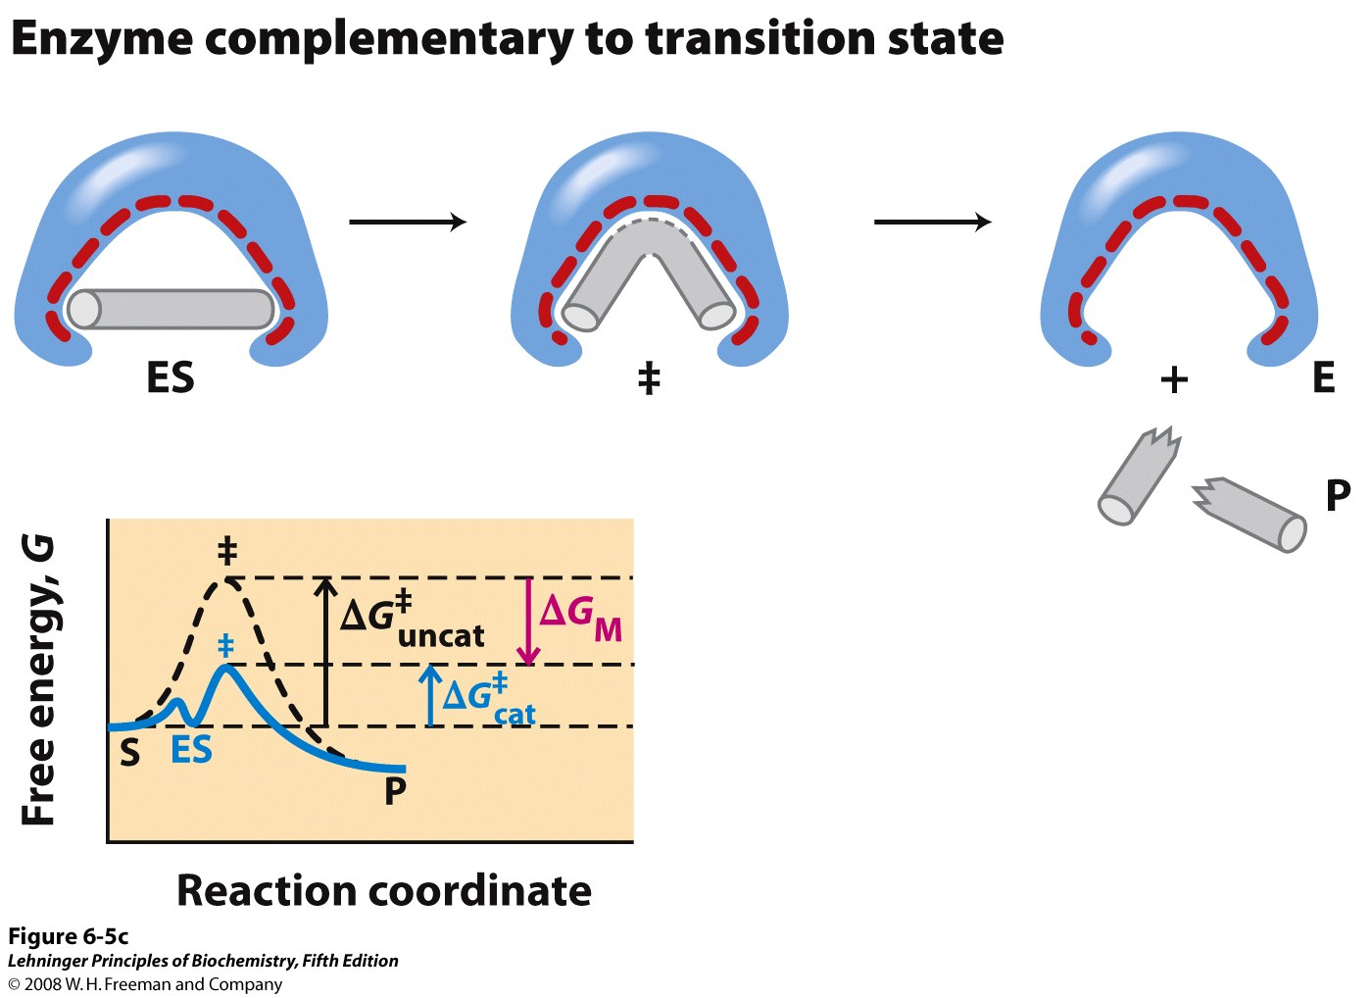
Notes:
FIGURE 6-5c An imaginary enzyme (stickase) designed to catalyze breakage of a metal stick. (c) An enzyme with a pocket complementary to the reaction transition state helps to destabilize the stick, contributing to catalysis of the reaction. The binding energy of the magnetic interactions compensates for the increase in free energy required to bend the stick. Reaction coordinate diagrams (right) show the energy consequences of complementarity to substrate versus complementarity to transition state (EP complexes are omitted). ΔG_{M}, the difference between the transition-state energies of the uncatalyzed and catalyzed reactions, is contributed by the magnetic interactions between the stick and stickase. When the enzyme is complementary to the substrate (b), the ES complex is more stable and has less free energy in the ground state than substrate alone. The result is an increase in the activation energy.

Slide 27
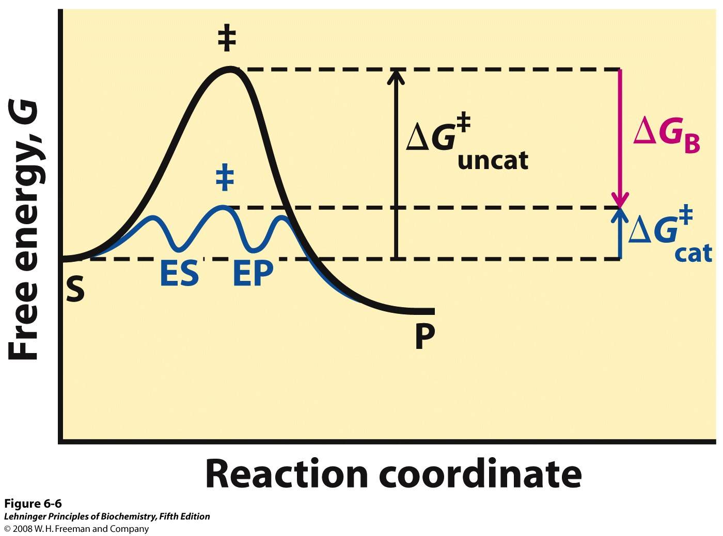
Notes:
FIGURE 6-6 Role of binding energy in catalysis. To lower the activation energy for a reaction, the system must acquire an amount of energy equivalent to the amount by which ΔG‡ is lowered. Much of this energy comes from binding energy (ΔG_{B}) contributed by formation of weak noncovalent interactions between substrate and enzyme in the transition state. The role of ΔG_{B} is analogous to that of ΔG_{M} in Figure 6-5.

Slide 28
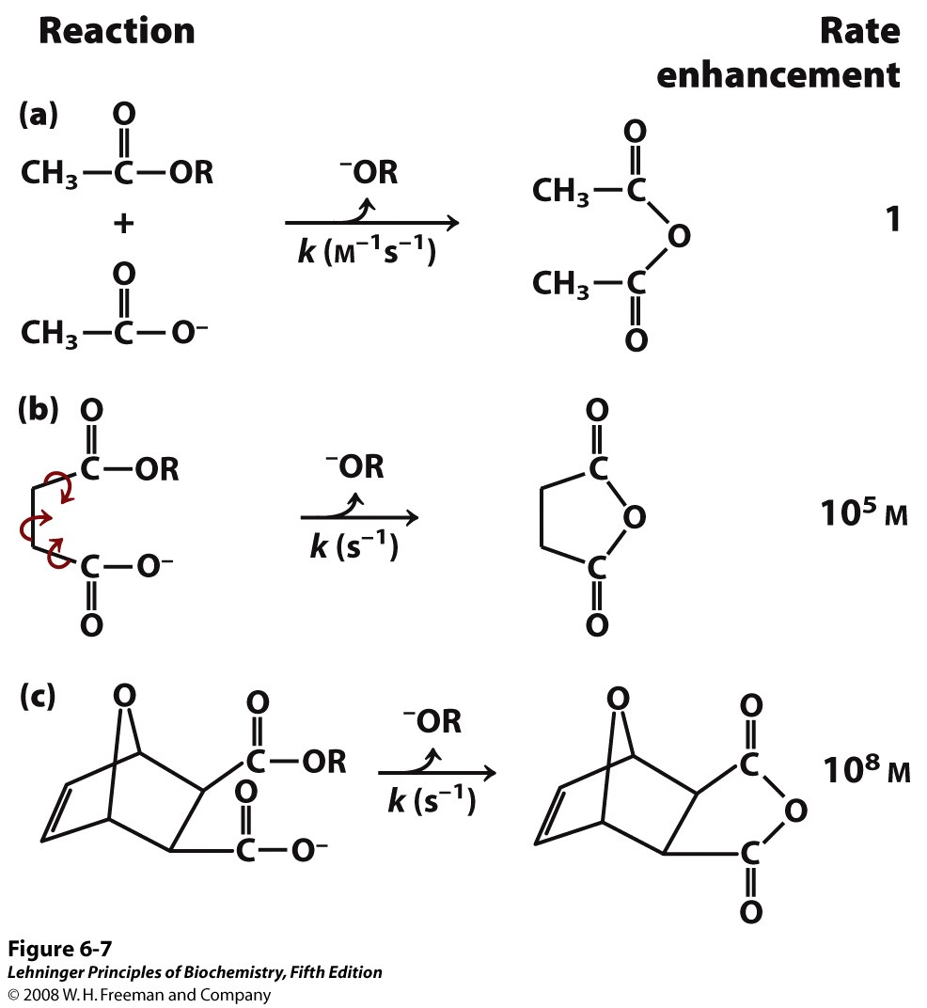
Notes:
FIGURE 6-7 Rate enhancement by entropy reduction. Shown here are reactions of an ester with a carboxylate group to form an anhydride. The R group is the same in each case. (a) For this bimolecular reaction, the rate constant k is second order, with units of M^{–1} s^{–1}. (b) When the two reacting groups are in a single molecule, and thus have less freedom of motion, the reaction is much faster. For this unimolecular reaction, k has units of s^{–1}. Dividing the rate constant for (b) by the rate constant for (a) gives a rate enhancement of about 10⁵ M. (The enhancement has units of molarity because we are comparing a unimolecular and a bimolecular reaction.) Put another way, if the reactant in (b) were present at a concentration of 1 M, the reacting groups would behave as though they were present at a concentration of 10₅ M. Note that the reactant in (b) has freedom of rotation about three bonds (shown with curved arrows), but this still represents a substantial reduction of entropy over (a). If the bonds that rotate in (b) are constrained as in (c), the entropy is reduced further and the reaction exhibits a rate enhancement of 108 M relative to (a).

Slide 29
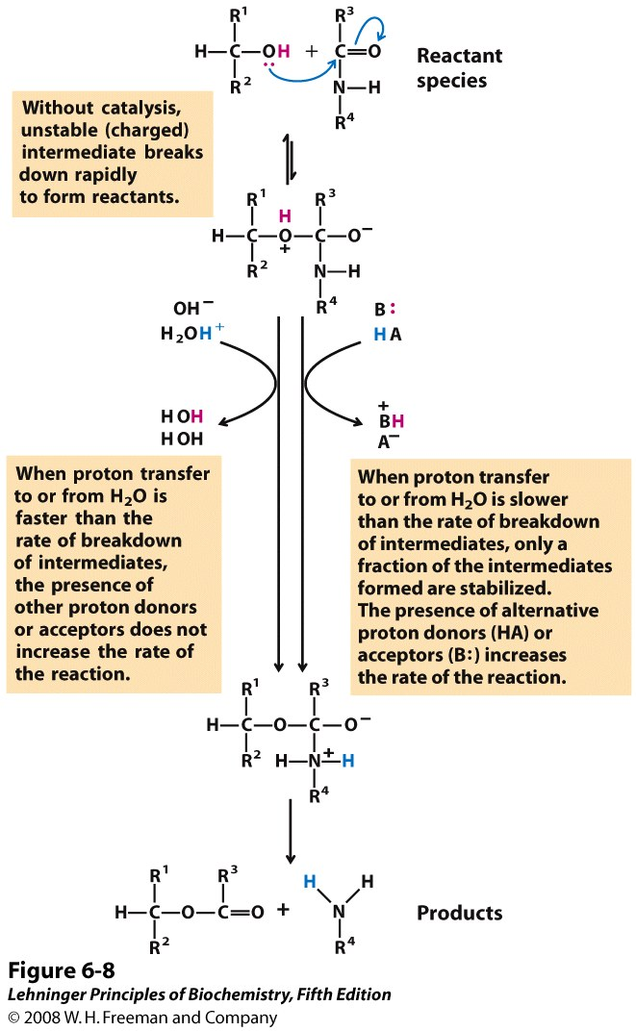
Notes:
FIGURE 6-8 How a catalyst circumvents unfavorable charge development during cleavage of an amide. The hydrolysis of an amide bond, shown here, is the same reaction as that catalyzed by chymotrypsin and other proteases. Charge development is unfavorable and can be circumvented by donation of a proton by H₃O⁺ (specific acid catalysis) or HA (general acid catalysis), where HA represents any acid. Similarly, charge can be neutralized by proton abstraction by OH– (specific base catalysis) or B: (general base catalysis), where B: represents any base.

Slide 30
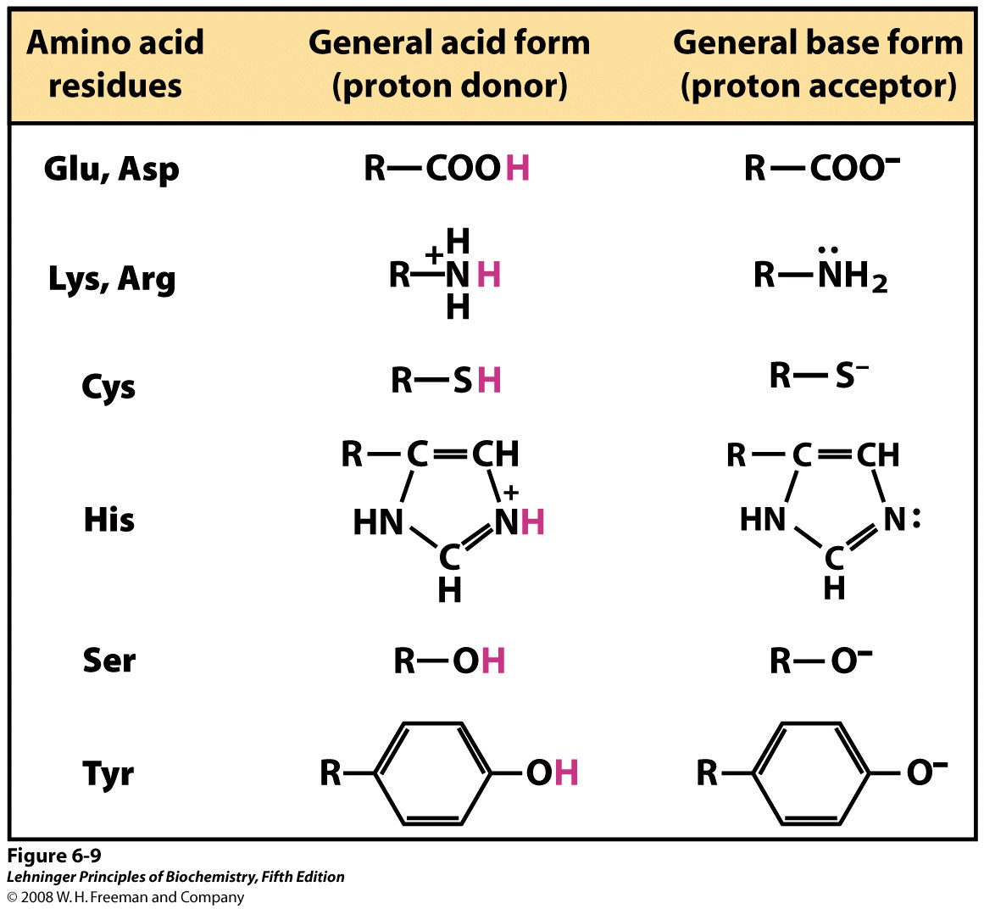
Notes:
FIGURE 6-9 Amino acids in general acid-base catalysis. Many organic reactions are promoted by proton donors (general acids) or proton acceptors (general bases). The active sites of some enzymes contain amino acid functional groups, such as those shown here, that can participate in the catalytic process as proton donors or proton acceptors.

Slide 31
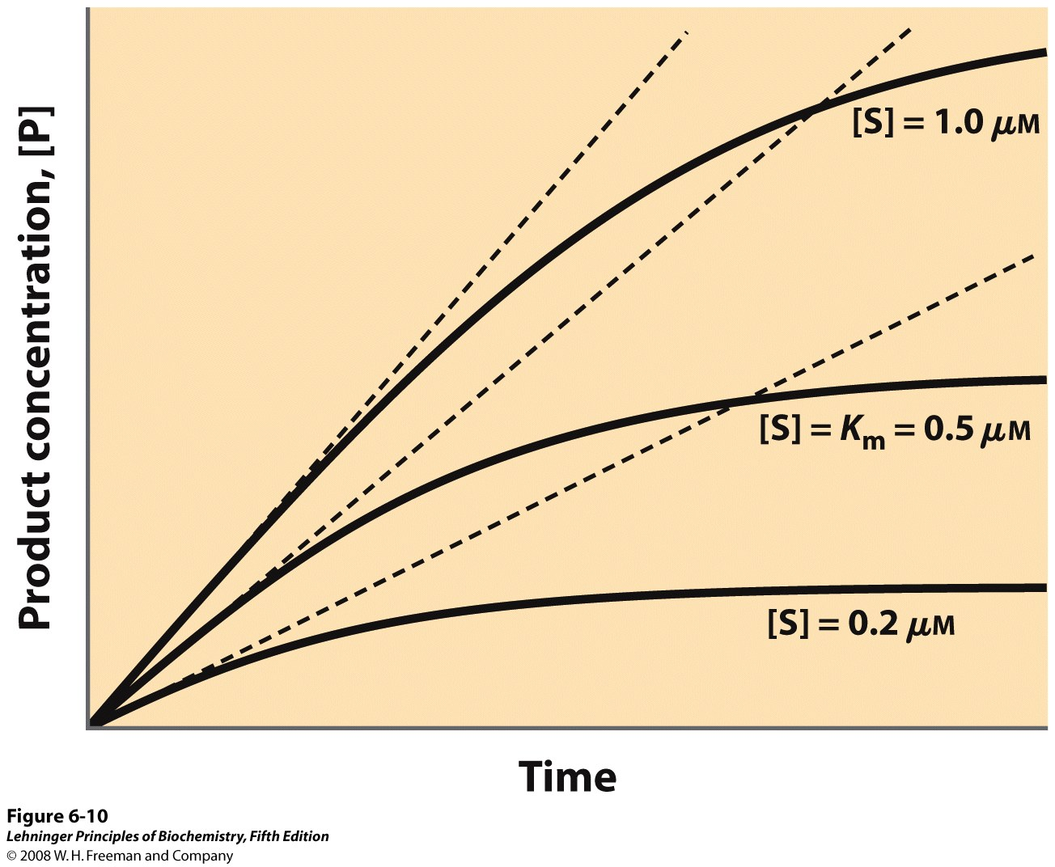
Notes:
FIGURE 6-10 Initial velocities of enzyme-catalyzed reactions. A theoretical enzyme catalyzes the reaction S ↔ P, and is present at a concentration sufficient to catalyze the reaction at a maximum velocity, V_{max}, of 1 μM/min. The Michaelis constant, K_{m} (explained in the text), is 0.5 μM. Progress curves are shown for substrate concentrations below, at, and above the K_{m}. The rate of an enzyme-catalyzed reaction declines as substrate is converted to product. A tangent to each curve taken at time = 0 defines the initial velocity, V0, of each reaction.

Slide 32
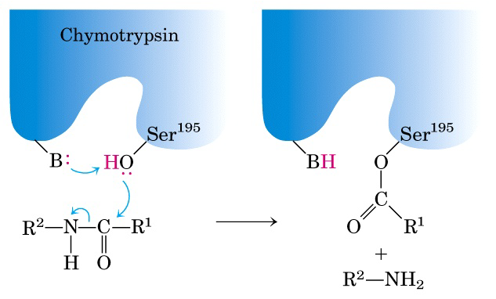

Slide 33
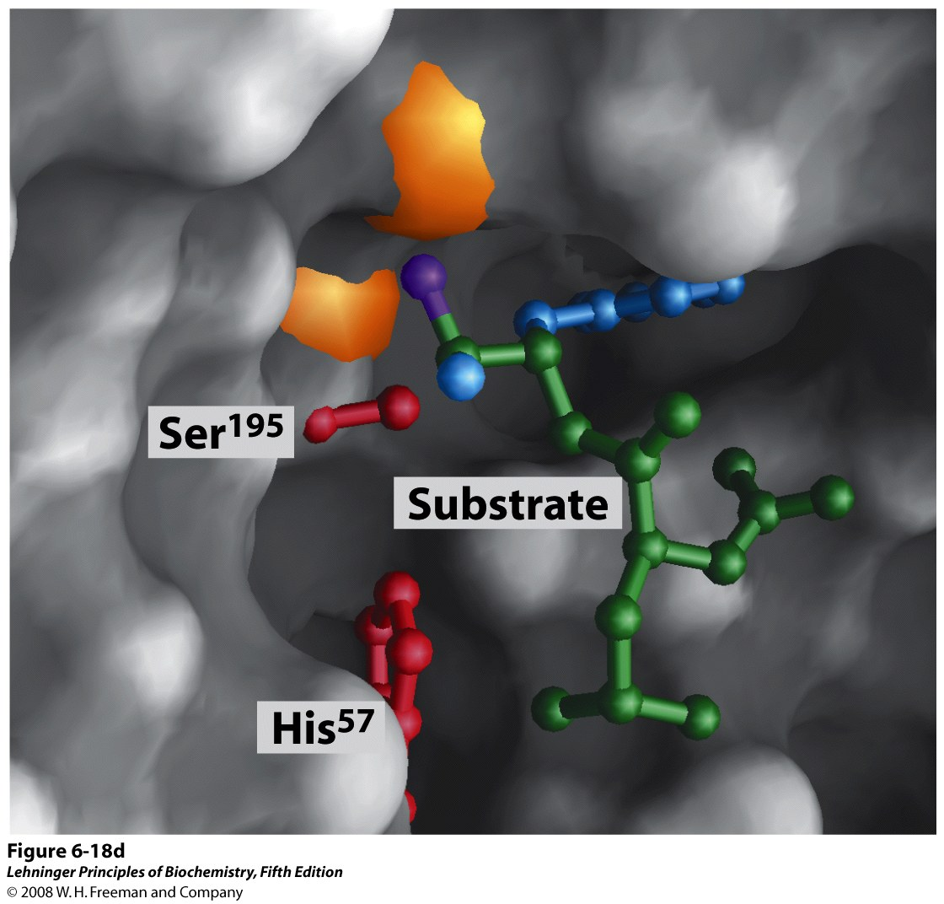
Notes:
FIGURE 6-18d Structure of chymotrypsin. (PDB ID 7GCH) (d) A close-up of the active site with a substrate (mostly green) bound. Two of the active-site residues, Ser¹⁹⁵ and His⁵⁷ (both red), are partly visible. The hydroxyl of Ser¹⁹⁵ attacks the carbonyl group of the substrate (the oxygen is purple); the developing negative charge on the oxygen is stabilized by the oxyanion hole (amide nitrogens, including one from Ser¹⁹⁵, in orange), as explained in Figure 6-21. In the substrate, the aromatic amino acid side chain and the amide nitrogen of the peptide bond to be cleaved (protruding toward the viewer and projecting the path of the rest of the substrate polypeptide chain) are in blue.

Slide 34
Enzyme Kinetics
Enzyme kinetics
Initial rate (or initial velocity)
Maximum velocity
Pre-steady state
Steady state
Steady-state kinetics
Steady-state assumption
Michaelis constant
Michaelis-Menten equation

Slide 35
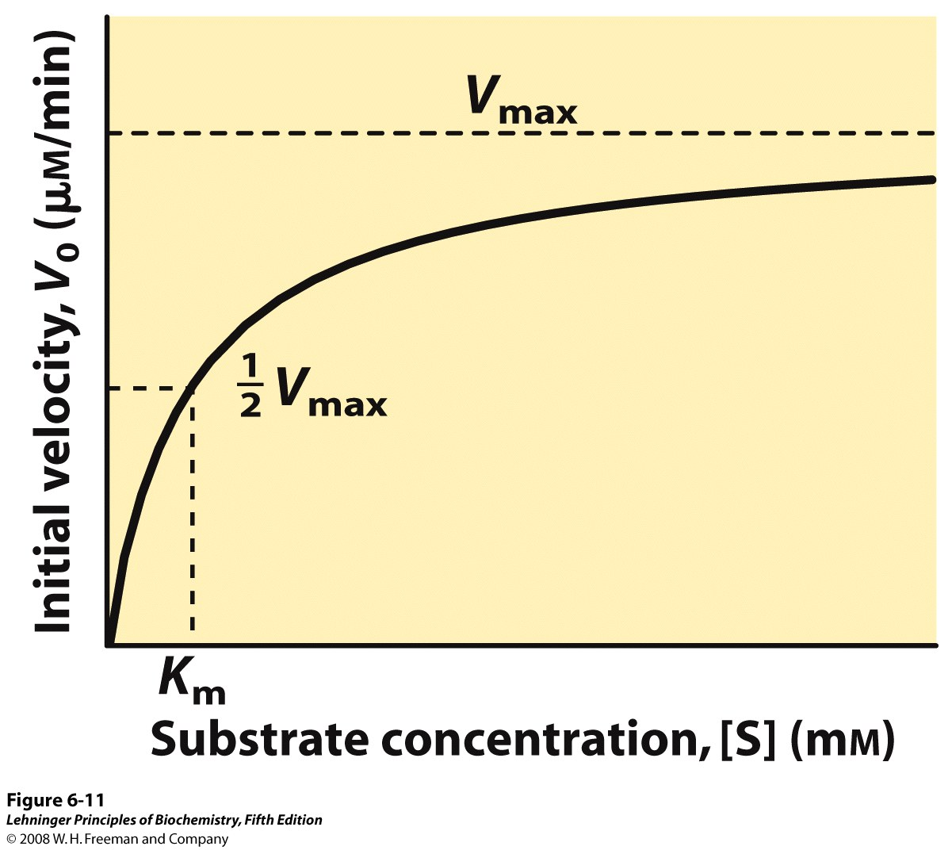
Notes:
FIGURE 6-11 Effect of substrate concentration on the initial velocity of an enzyme-catalyzed reaction. The maximum velocity, V_{max}, is extrapolated from the plot, because V₀ approaches but never quite reaches V_{max}. The substrate concentration at which V₀ is half maximal is K_{m}, the Michaelis constant. The concentration of enzyme in an experiment such as this is generally so low that [S] >> [E] even when [S] is described as low or relatively low. The units shown are typical for enzyme-catalyzed reactions and are given only to help illustrate the meaning of V0 and [S]. (Note that the curve describes part of a rectangular hyperbola, with one asymptote at Vmax. If the curve were continued below [S] = 0, it would approach a vertical asymptote at [S] = –Km.)

Slide 36
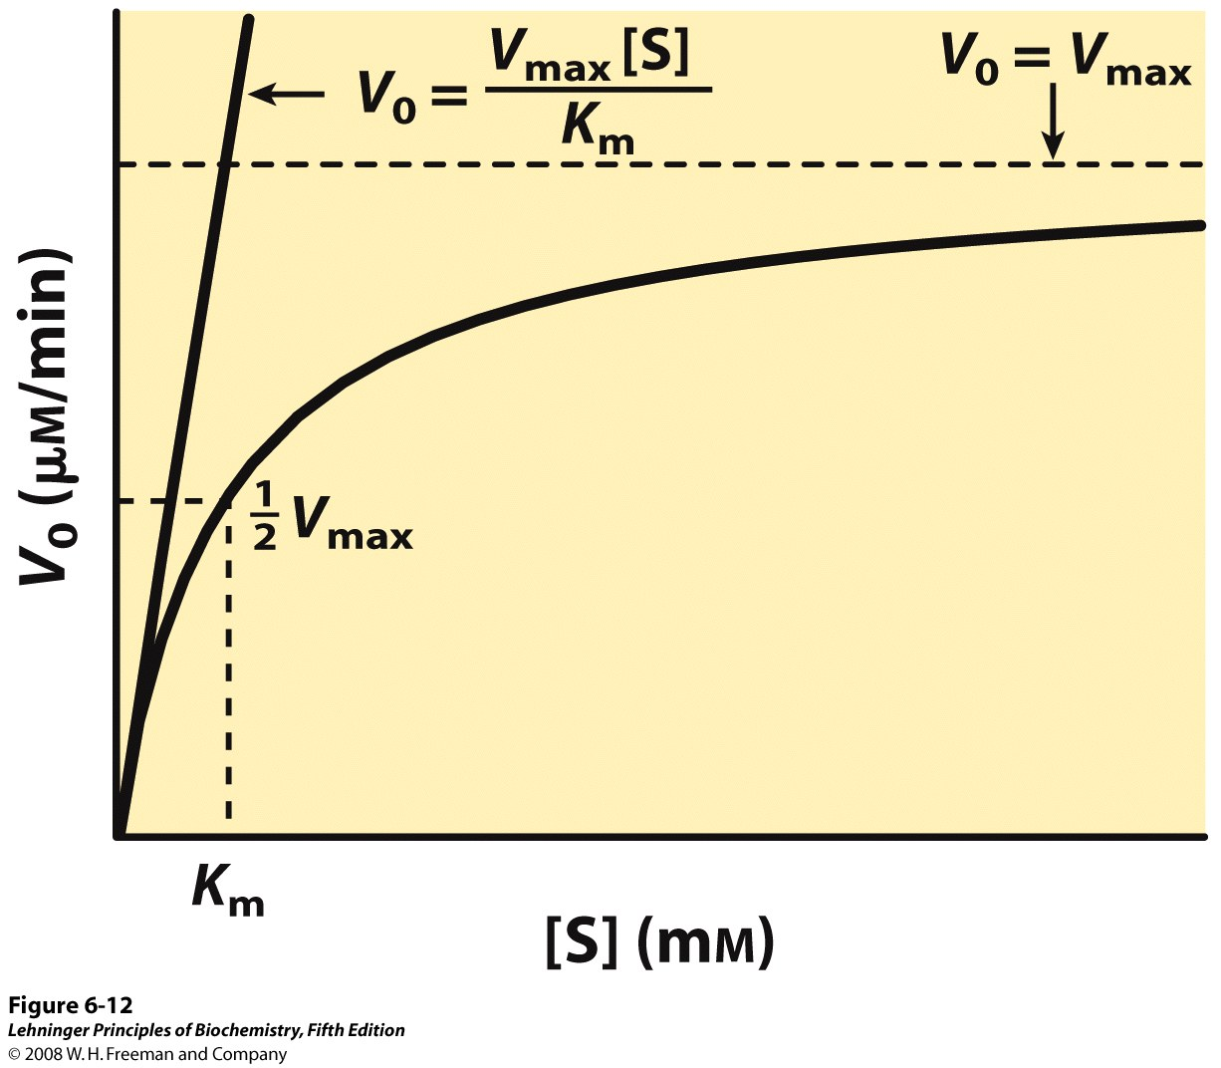
Notes:
FIGURE 6-12 Dependence of initial velocity on substrate concentration. This graph shows the kinetic parameters that define the limits of the curve at high and low [S]. At low [S], K_{m} >> [S] and the [S] term in the denominator of the Michaelis-Menten equation (Eqn 6-9) becomes insignificant. The equation simplifies to V₀ = V_{max}[S]/K_{m} and V₀ exhibits a linear dependence on [S], as observed here. At high [S], where [S] >> Km, the Km term in the denominator of the Michaelis-Menten equation becomes insignificant and the equation simplifies to V0 = Vmax; this is consistent with the plateau observed at high [S]. The Michaelis-Menten equation is therefore consistent with the observed dependence of V0 on [S], and the shape of the curve is defined by the terms Vmax/Km at low [S] and Vmax at high [S].

Slide 37
Double-reciprocal plot
Dissociation constant
Turnover number

Slide 38
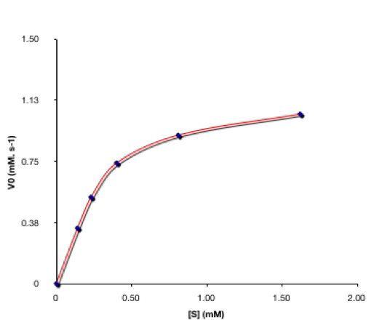

Slide 39
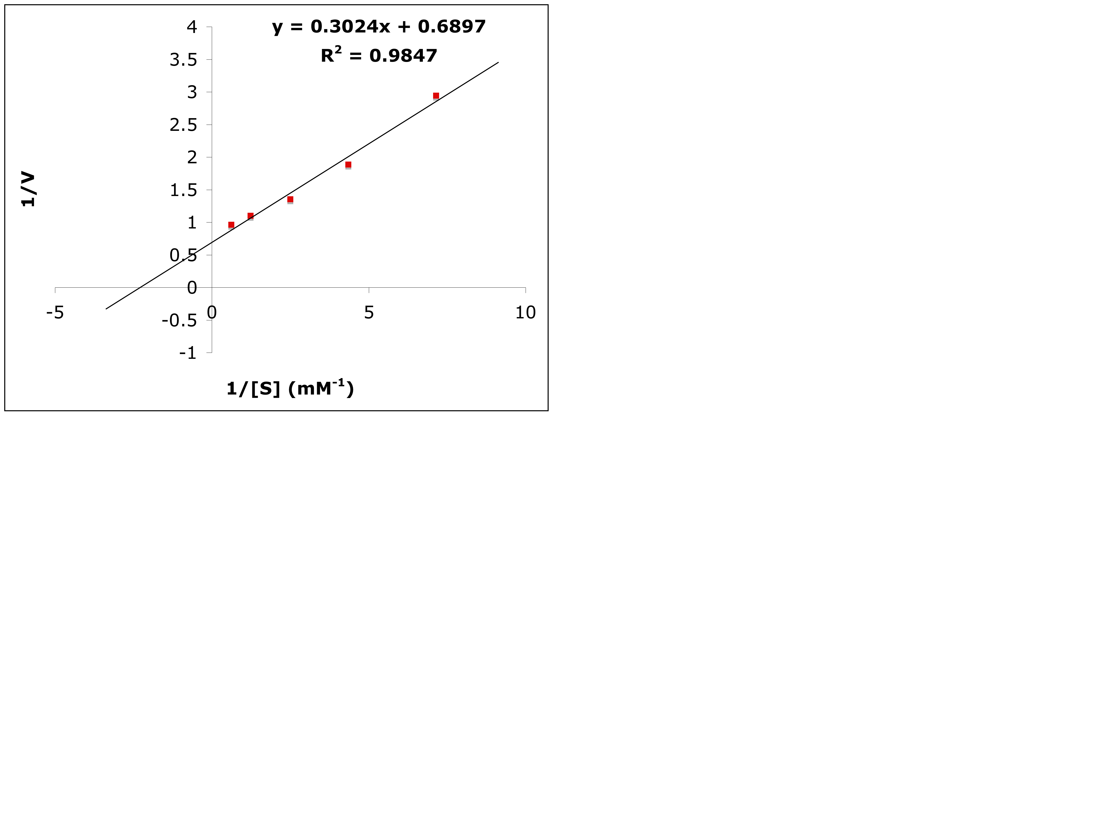
Lineweaver-Burk Plot
V_{max} = 1/0.6897 = 1.45
K_{m} = -1/(-2.28) = 0.44 μM)

Slide 40
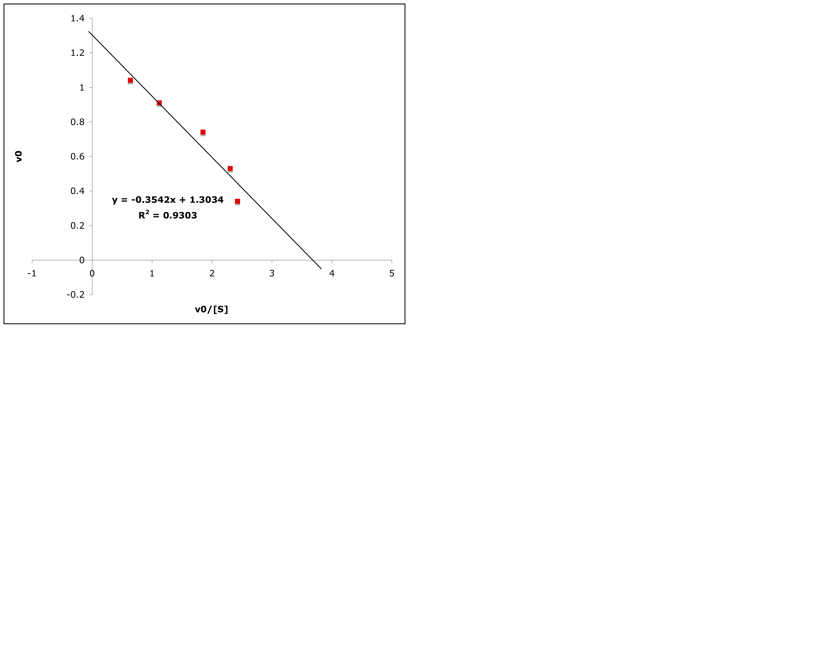
Eadie-Hofstee Plot
V_{max} = 1.30
K_{m} = 0.354

Slide 41
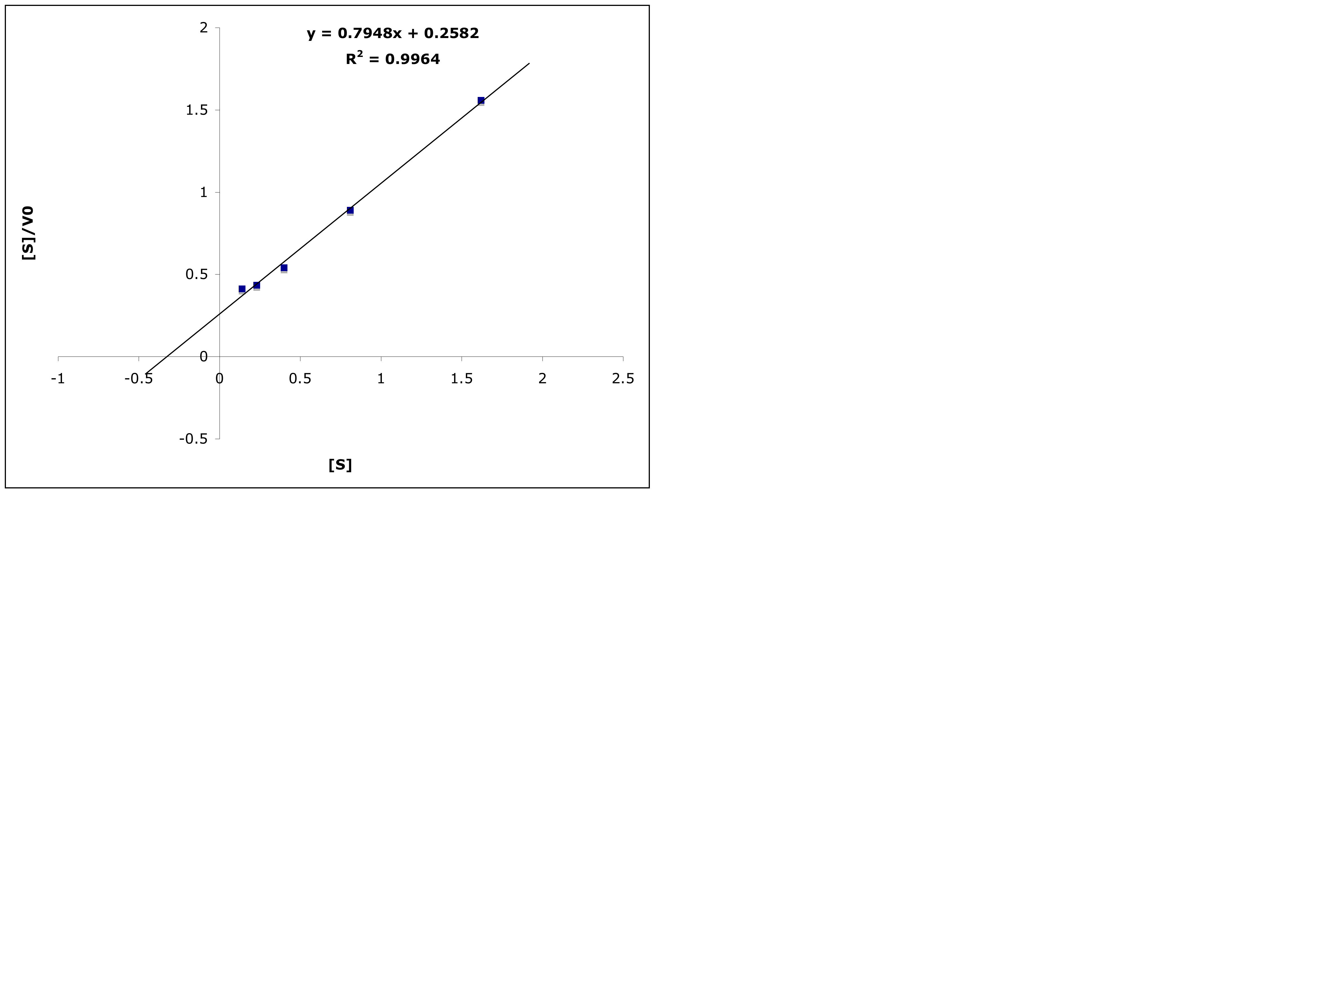
Haynes-Woolf Plot
K_{m} = 0.32
V_{max} = 0.80

Slide 42
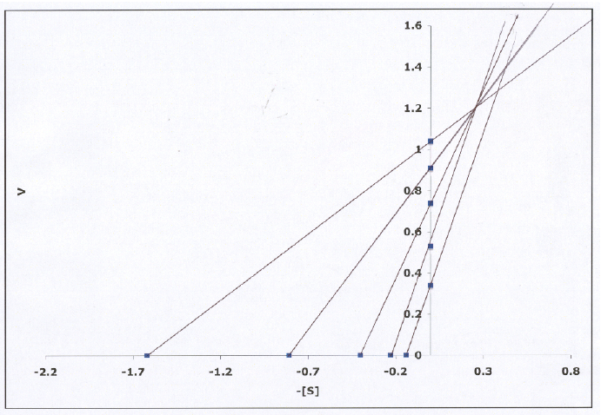
Eisenthal-Cornish-Bowden Direct Plot
Direct Linear Plot

Slide 43
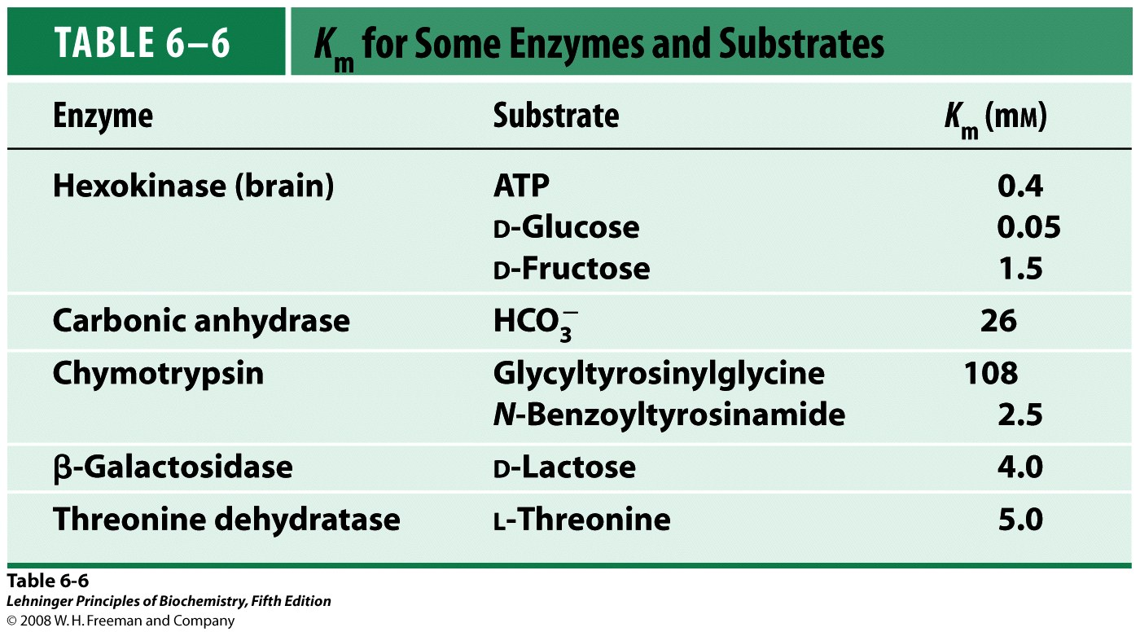

Slide 44
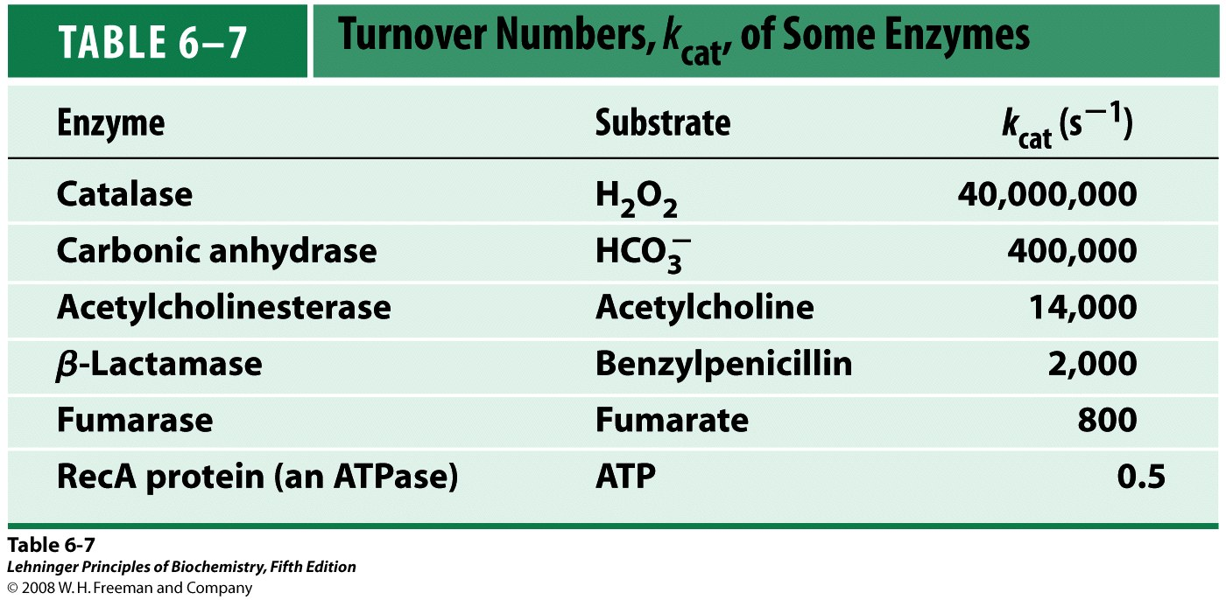

Slide 45
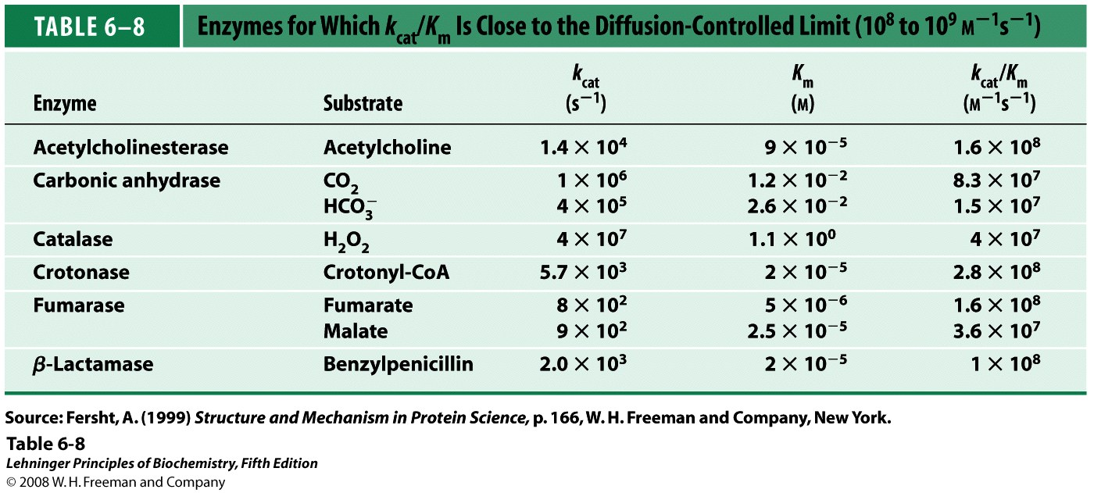

Slide 46
More complex systems

Slide 47
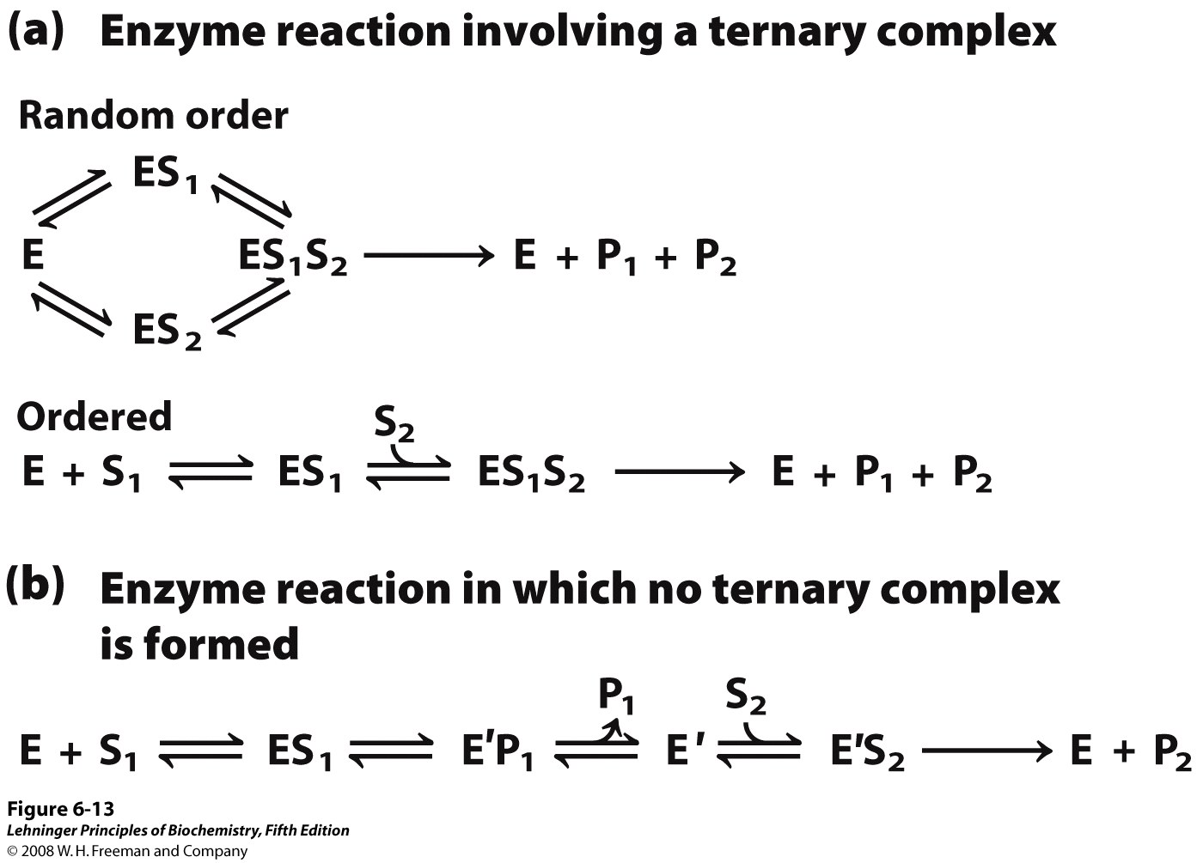
Notes:
FIGURE 6-13 Common mechanisms for enzyme-catalyzed bisubstrate reactions. (a) The enzyme and both substrates come together to form a ternary complex. In ordered binding, substrate 1 must bind before substrate 2 can bind productively. In random binding, the substrates can bind in either order. (b) An enzyme-substrate complex forms, a product leaves the complex, the altered enzyme forms a second complex with another substrate molecule, and the second product leaves, regenerating the enzyme. Substrate 1 may transfer a functional group to the enzyme (to form the covalently modified E′), which is subsequently transferred to substrate 2. This is called a Ping-Pong or double-displacement mechanism.

Slide 48
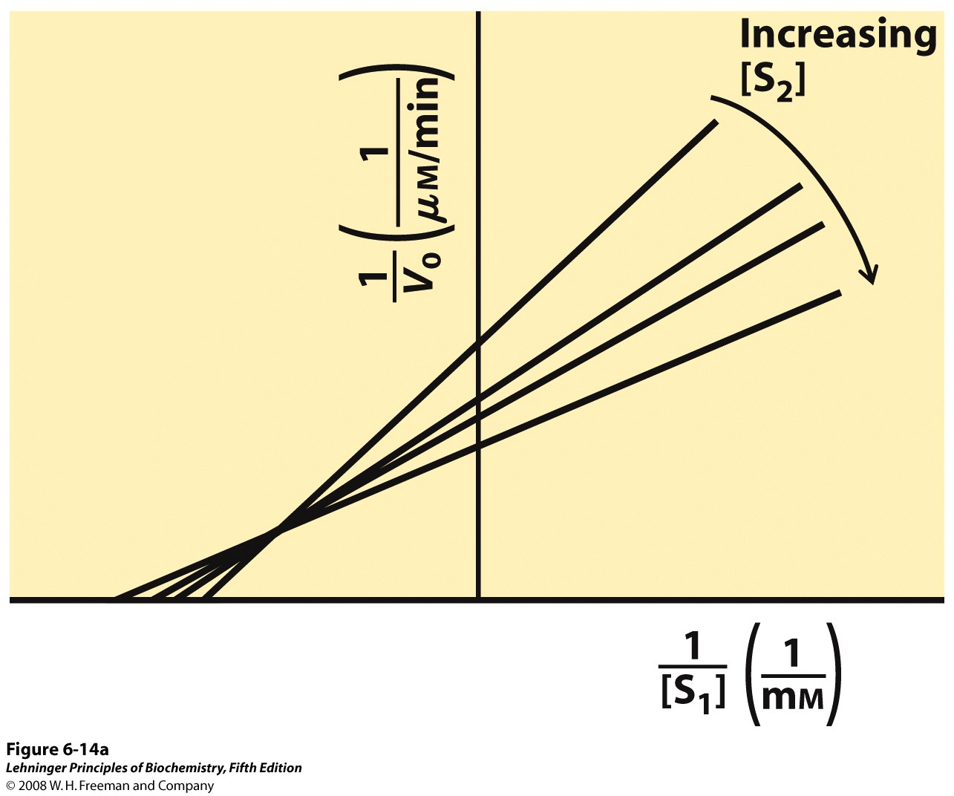
Notes:
FIGURE 6-14a Steady-state kinetic analysis of bisubstrate reactions. In these double-reciprocal plots (see Box 6-1), the concentration of substrate 1 is varied while the concentration of substrate 2 is held constant. This is repeated for several values of [S₂], generating several separate lines. (a) Intersecting lines indicate that a ternary complex is formed in the reaction; (b) parallel lines indicate a Ping-Pong (double-displacement) pathway.

Slide 49
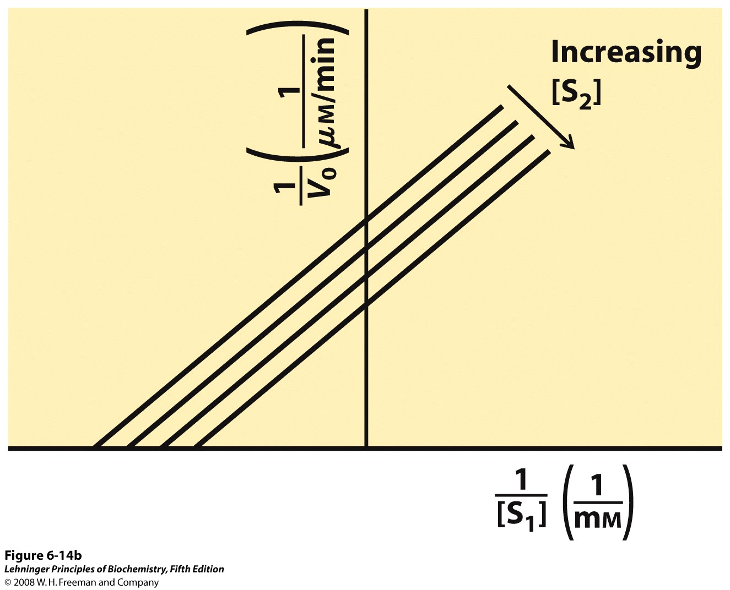
Notes:
FIGURE 6-14b Steady-state kinetic analysis of bisubstrate reactions. In these double-reciprocal plots (see Box 6-1), the concentration of substrate 1 is varied while the concentration of substrate 2 is held constant. This is repeated for several values of [S₂], generating several separate lines. (a) Intersecting lines indicate that a ternary complex is formed in the reaction; (b) parallel lines indicate a Ping-Pong (double-displacement) pathway.

Slide 50
Reversible Inhibition

Slide 51
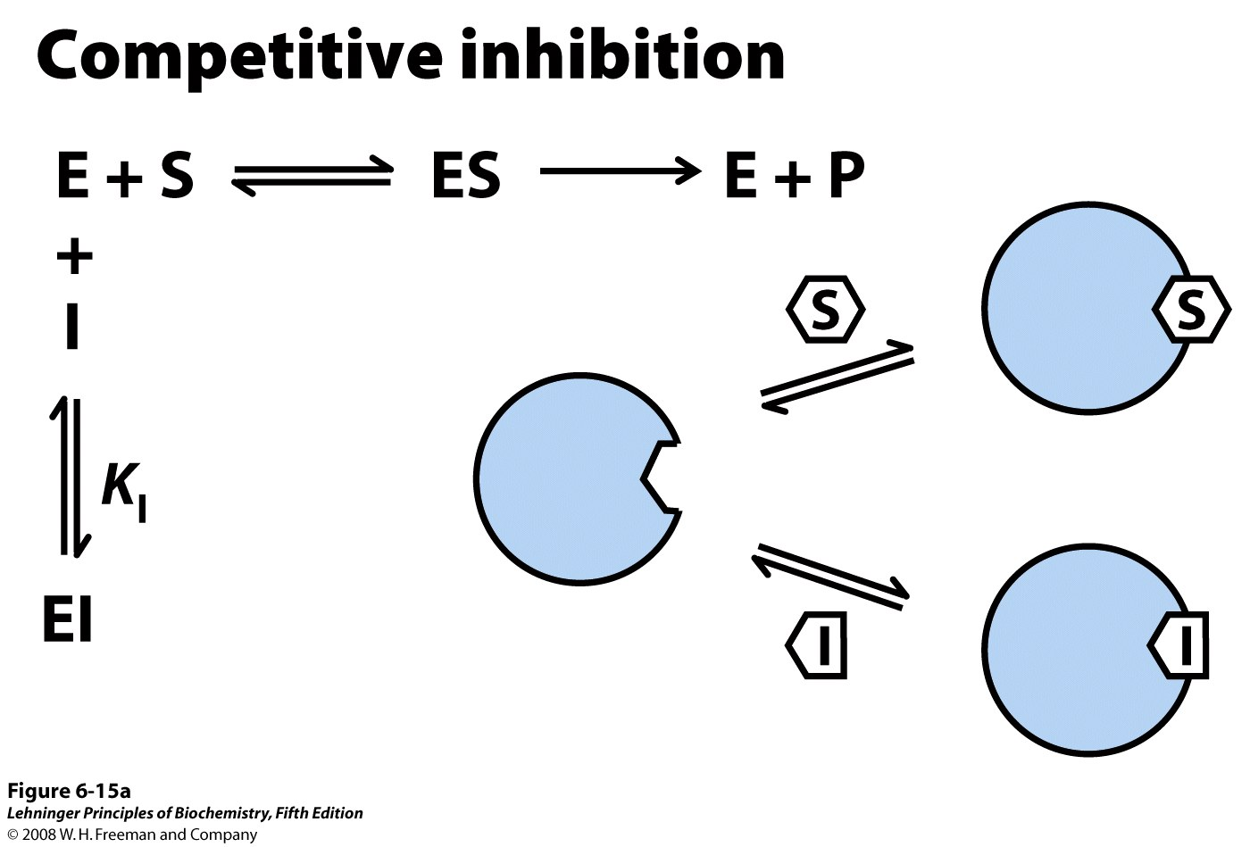
Notes:
FIGURE 6-15a Three types of reversible inhibition. (a) Competitive inhibitors bind to the enzyme's active site; K_{I} is the equilibrium constant for inhibitor binding to E.

Slide 52
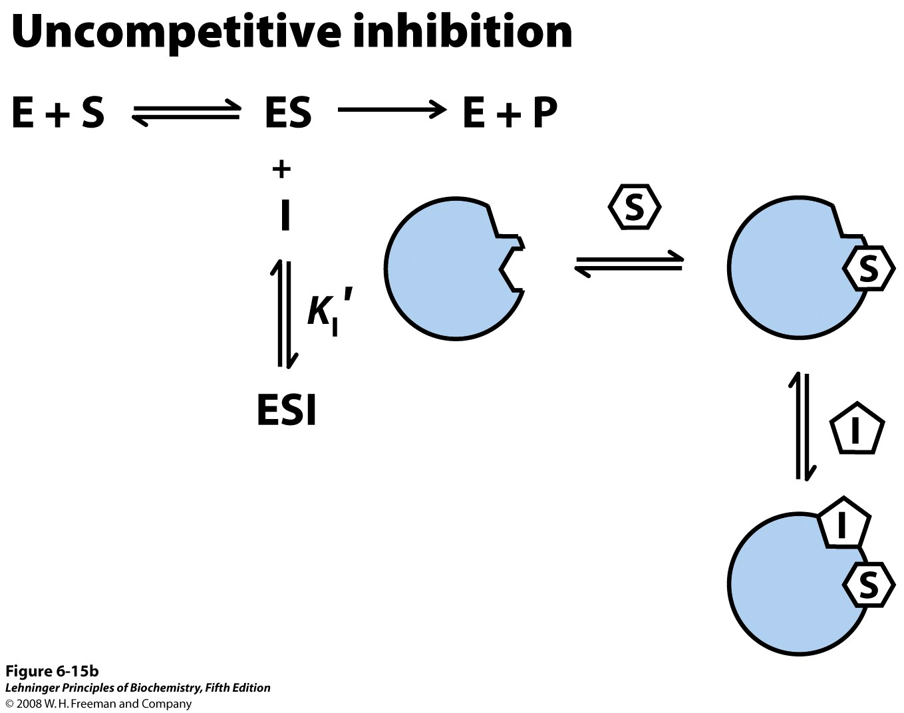
Notes:
FIGURE 6-15b Three types of reversible inhibition. (b) Uncompetitive inhibitors bind at a separate site, but bind only to the ES complex; K_{I}′ is the equilibrium constant for inhibitor binding to ES.

Slide 53
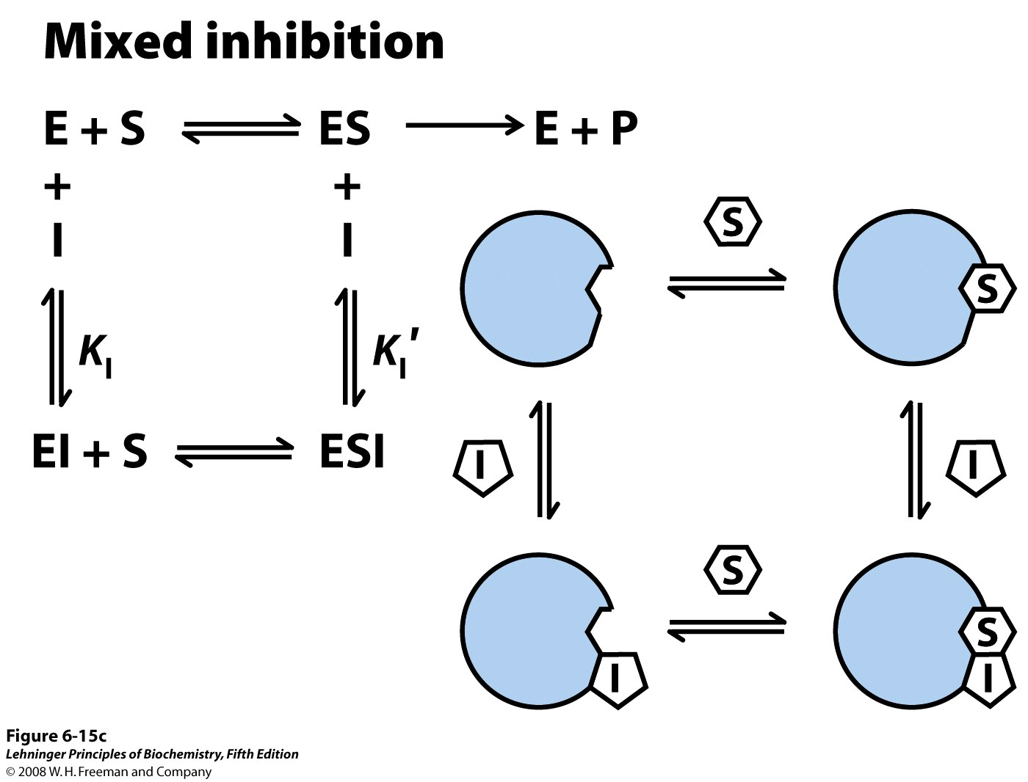
Notes:
FIGURE 6-15c Three types of reversible inhibition. (c) Mixed inhibitors bind at a separate site, but may bind to either E or ES.

Slide 54
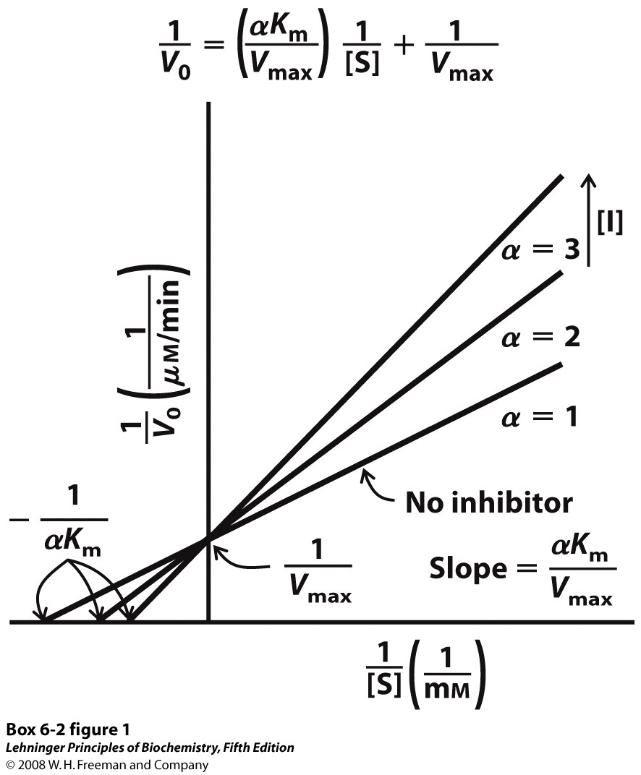
Notes:
BOX 6-2 FIGURE 1 Competitive inhibition.

Slide 55
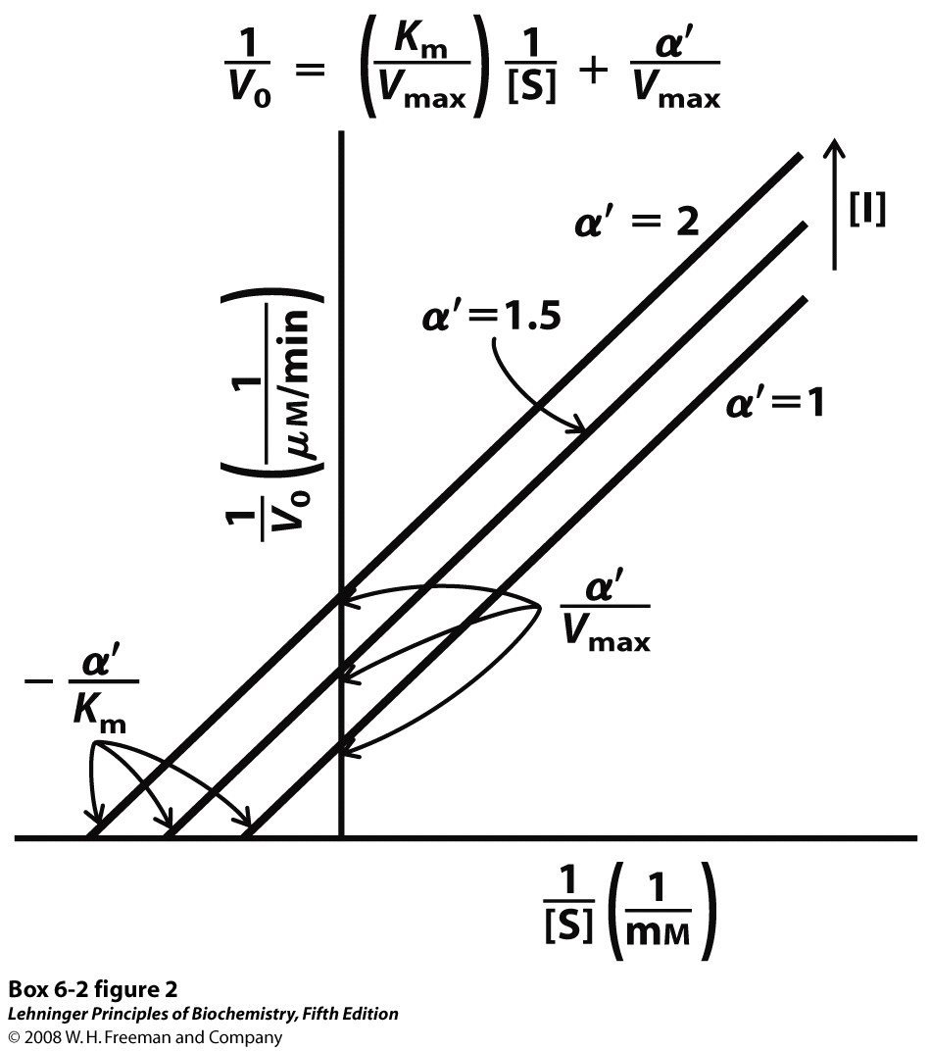
Notes:
BOX 6-2 FIGURE 2 Uncompetitive inhibition.

Slide 56
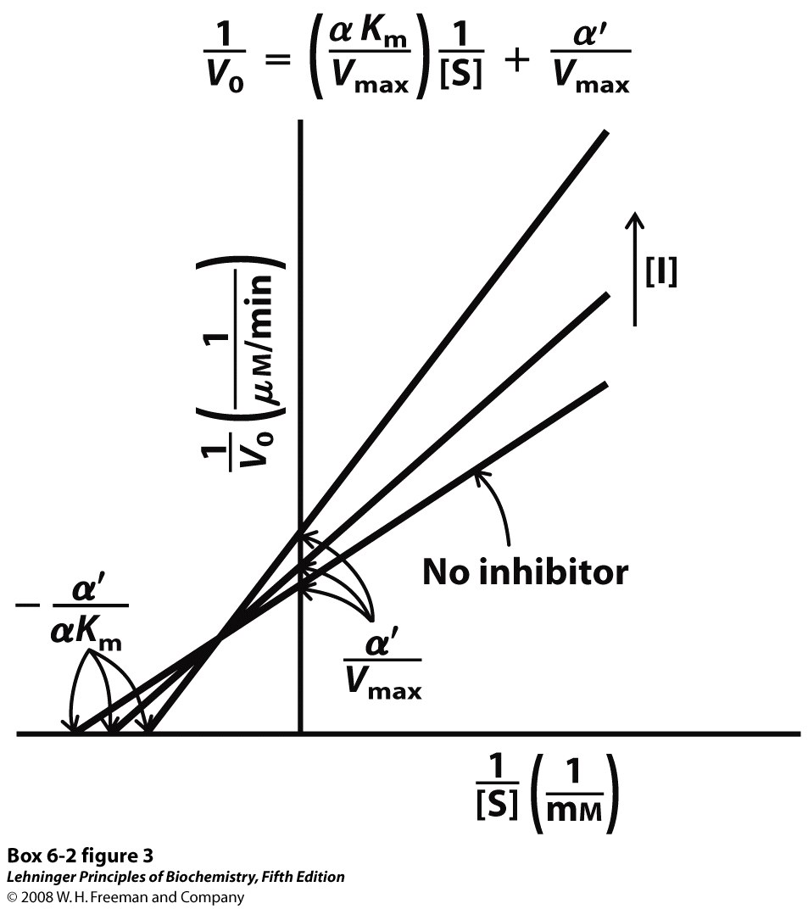
Notes:
BOX 6-2 FIGURE 3 Mixed inhibition.

Slide 57
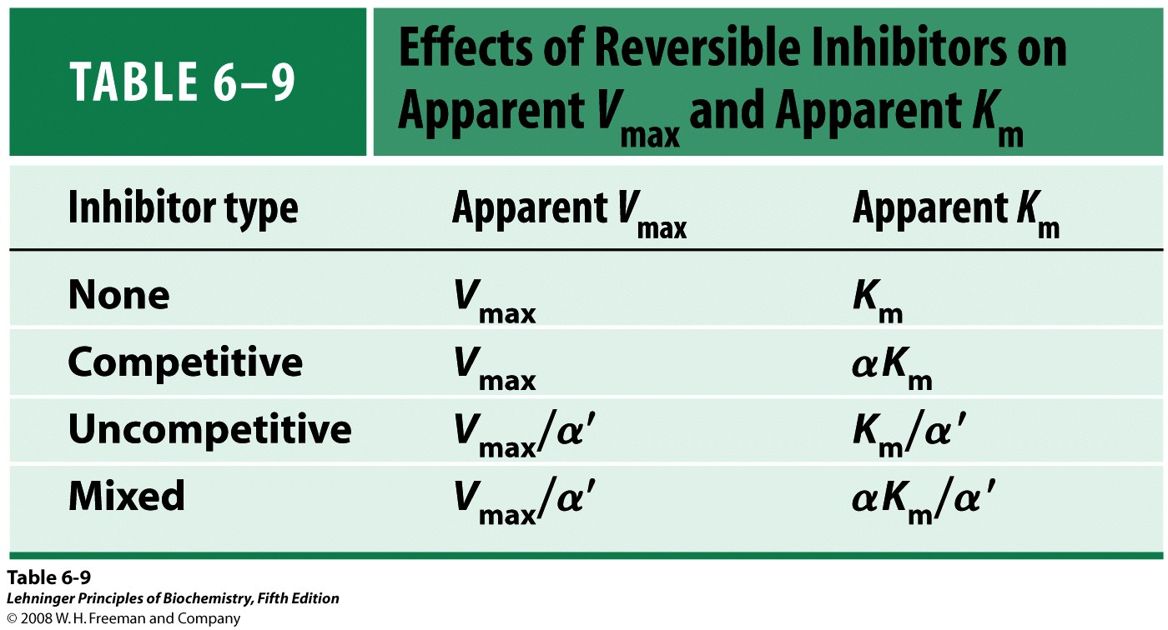

Slide 58
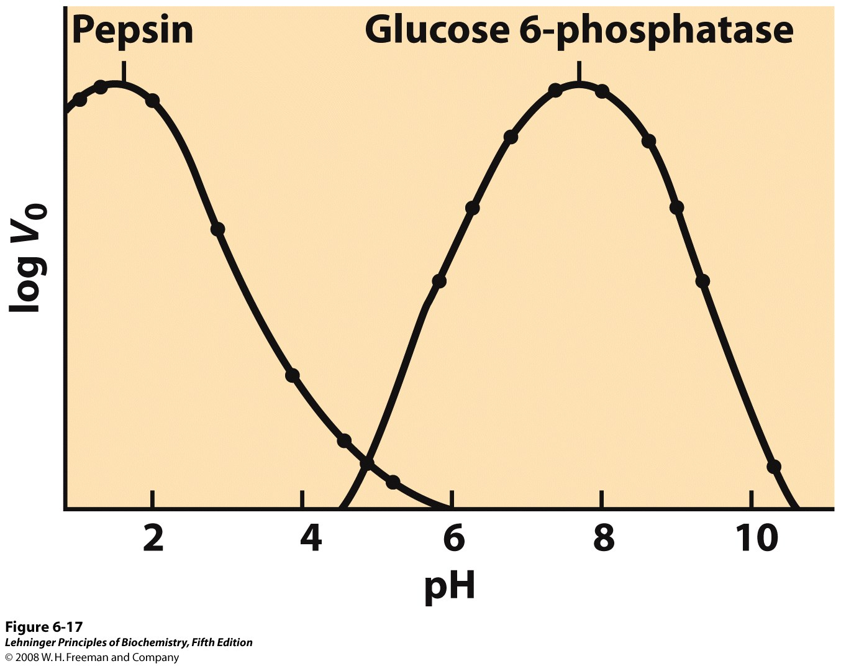
Notes:
FIGURE 6-17 The pH-activity profiles of two enzymes. These curves are constructed from measurements of initial velocities when the reaction is carried out in buffers of different pH. Because pH is a logarithmic scale reflecting tenfold changes in [H⁺], the changes in V₀ are also plotted on a logarithmic scale. The pH optimum for the activity of an enzyme is generally close to the pH of the environment in which the enzyme is normally found. Pepsin, which hydrolyzes certain peptide bonds of proteins during digestion in the stomach, has a pH optimum of about 1.6. The pH of gastric juice is between 1 and 2. Glucose 6-phosphatase of hepatocytes (liver cells), with a pH optimum of about 7.8, is responsible for releasing glucose into the blood. The normal pH of the cytosol of hepatocytes is about 7.2.

Slide 59
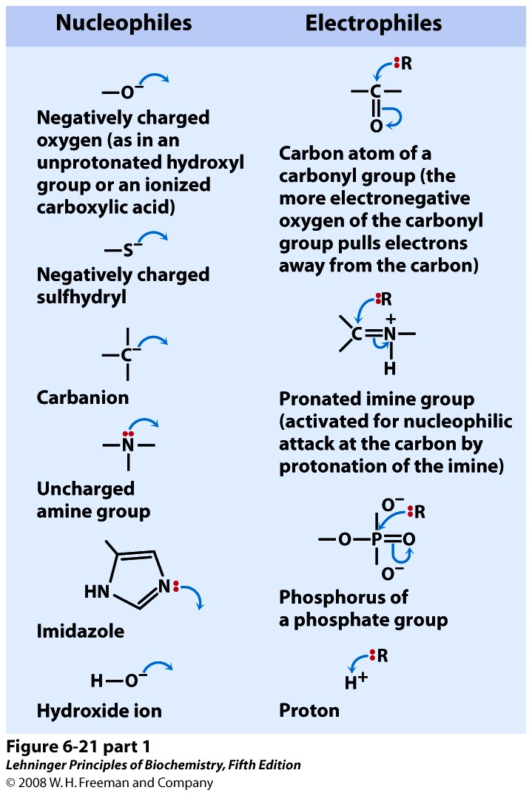
Notes:
FIGURE 6-21 (part 1) Hydrolytic cleavage of a peptide bond by chymotrypsin. The reaction has two phases. In the acylation phase (steps 1 to 3), formation of a covalent acyl-enzyme intermediate is coupled to cleavage of the peptide bond. In the deacylation phase (steps 4 to 7), deacylation regenerates the free enzyme; this is essentially the reverse of the acylation phase, with water mirroring, in reverse, the role of the amine component of the substrate.

Slide 60
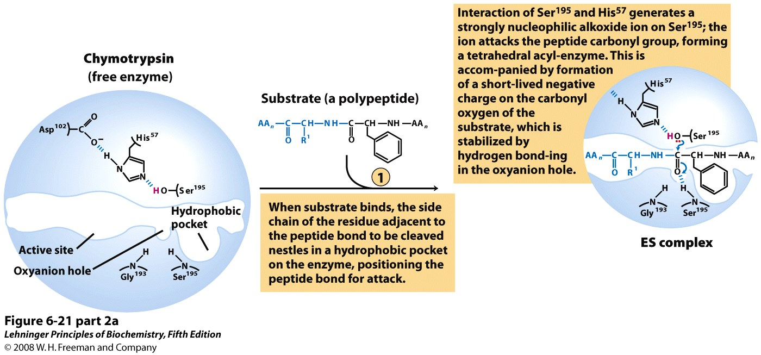
Notes:
FIGURE 6-21 (part 2a) Hydrolytic cleavage of a peptide bond by chymotrypsin. The reaction has two phases. In the acylation phase (steps 1 to 3), formation of a covalent acyl-enzyme intermediate is coupled to cleavage of the peptide bond. In the deacylation phase (steps 4 to 7), deacylation regenerates the free enzyme; this is essentially the reverse of the acylation phase, with water mirroring, in reverse, the role of the amine component of the substrate.

Slide 61
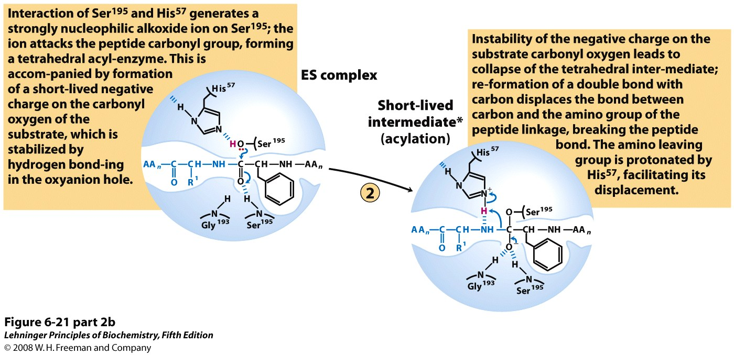
Notes:
FIGURE 6-21 (part 2b) Hydrolytic cleavage of a peptide bond by chymotrypsin. The reaction has two phases. In the acylation phase (steps 1 to 3), formation of a covalent acyl-enzyme intermediate is coupled to cleavage of the peptide bond. In the deacylation phase (steps 4 to 7), deacylation regenerates the free enzyme; this is essentially the reverse of the acylation phase, with water mirroring, in reverse, the role of the amine component of the substrate.

Slide 62
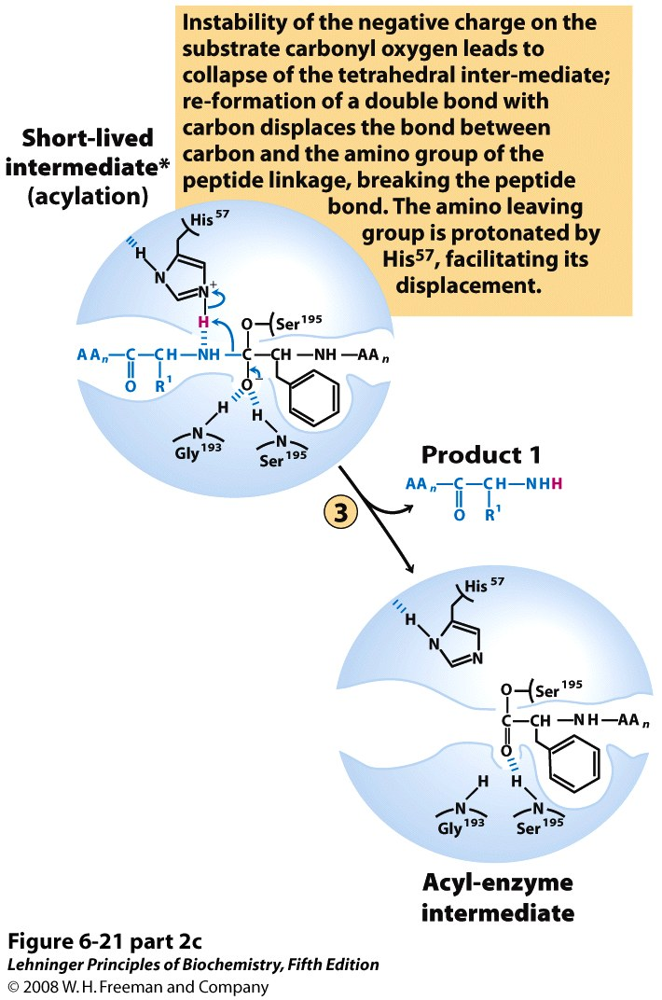
Notes:
FIGURE 6-21 (part 2c) Hydrolytic cleavage of a peptide bond by chymotrypsin. The reaction has two phases. In the acylation phase (steps 1 to 3), formation of a covalent acyl-enzyme intermediate is coupled to cleavage of the peptide bond. In the deacylation phase (steps 4 to 7), deacylation regenerates the free enzyme; this is essentially the reverse of the acylation phase, with water mirroring, in reverse, the role of the amine component of the substrate.

Slide 63
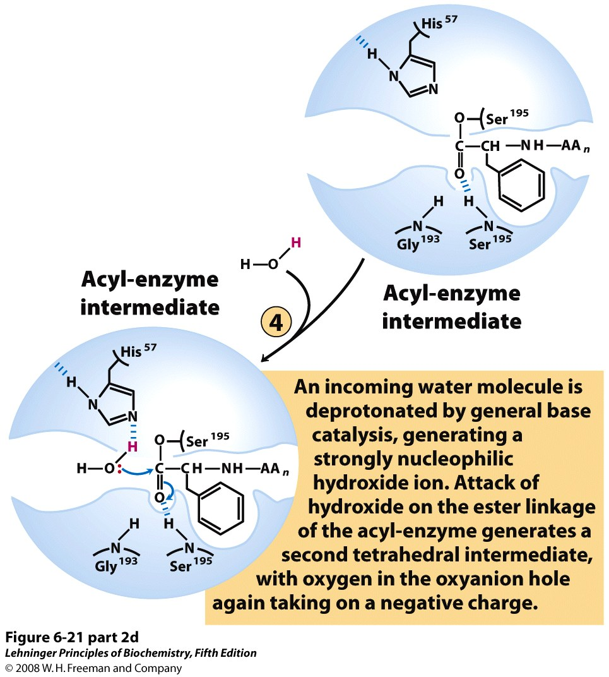
Notes:
FIGURE 6-21 (part 2d) Hydrolytic cleavage of a peptide bond by chymotrypsin. The reaction has two phases. In the acylation phase (steps 1 to 3), formation of a covalent acyl-enzyme intermediate is coupled to cleavage of the peptide bond. In the deacylation phase (steps 4 to 7), deacylation regenerates the free enzyme; this is essentially the reverse of the acylation phase, with water mirroring, in reverse, the role of the amine component of the substrate.

Slide 64
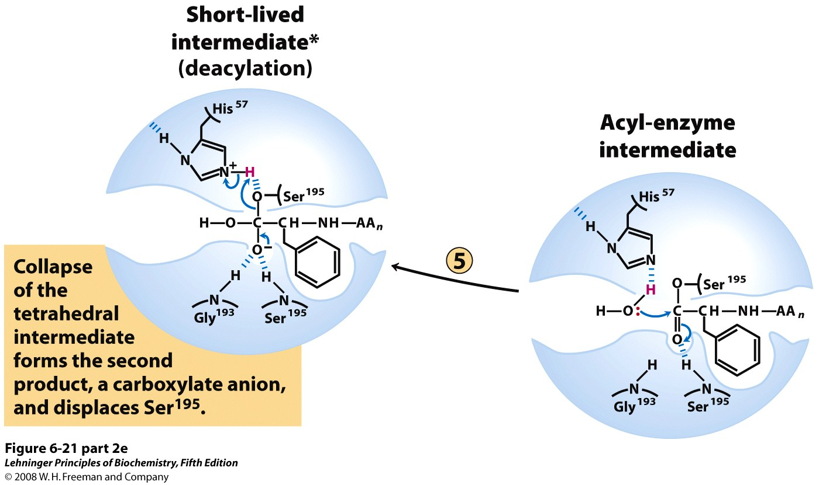
Notes:
FIGURE 6-21 (part 2e) Hydrolytic cleavage of a peptide bond by chymotrypsin. The reaction has two phases. In the acylation phase (steps 1 to 3), formation of a covalent acyl-enzyme intermediate is coupled to cleavage of the peptide bond. In the deacylation phase (steps 4 to 7), deacylation regenerates the free enzyme; this is essentially the reverse of the acylation phase, with water mirroring, in reverse, the role of the amine component of the substrate.

Slide 65
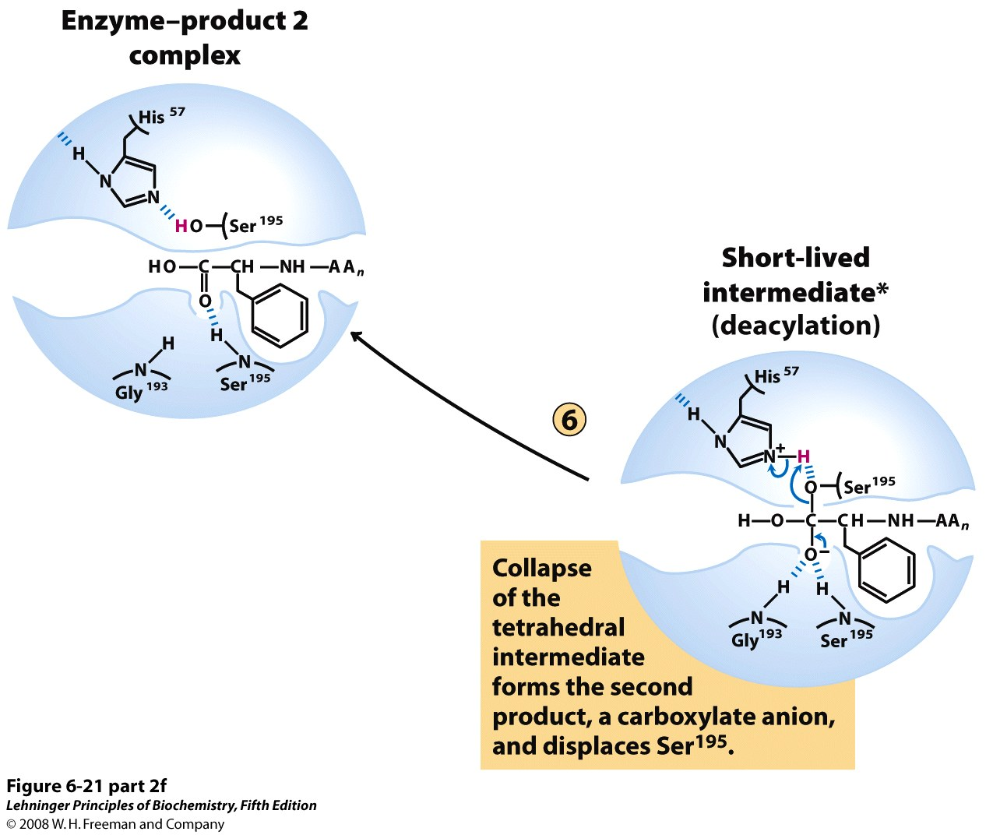
Notes:
FIGURE 6-21 (part 2f) Hydrolytic cleavage of a peptide bond by chymotrypsin. The reaction has two phases. In the acylation phase (steps 1 to 3), formation of a covalent acyl-enzyme intermediate is coupled to cleavage of the peptide bond. In the deacylation phase (steps 4 to 7), deacylation regenerates the free enzyme; this is essentially the reverse of the acylation phase, with water mirroring, in reverse, the role of the amine component of the substrate.

Slide 66
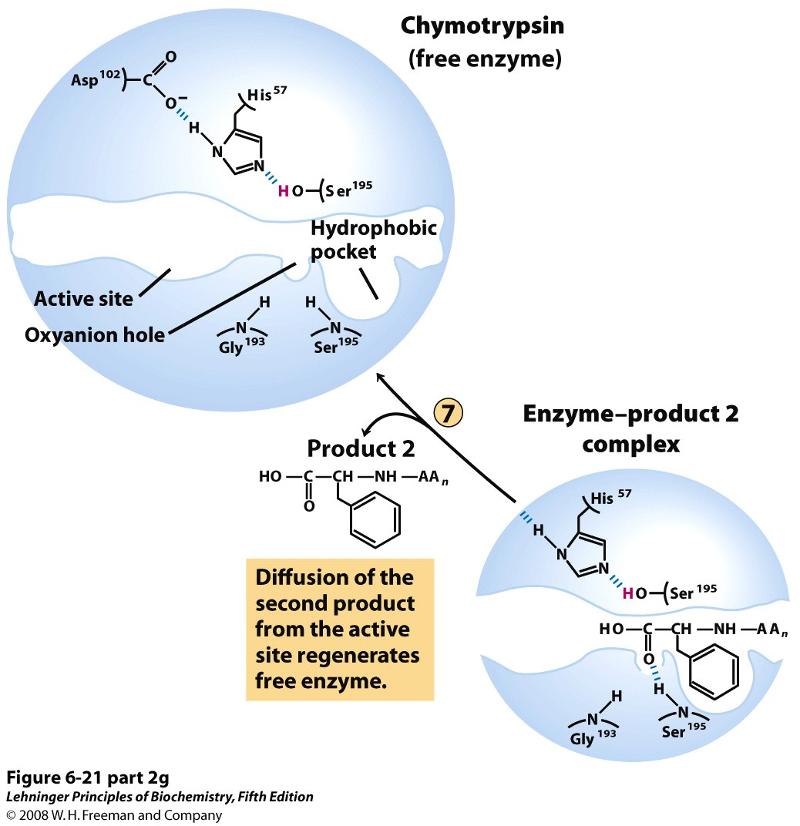
Notes:
FIGURE 6-21 (part 2g) Hydrolytic cleavage of a peptide bond by chymotrypsin. The reaction has two phases. In the acylation phase (steps 1 to 3), formation of a covalent acyl-enzyme intermediate is coupled to cleavage of the peptide bond. In the deacylation phase (steps 4 to 7), deacylation regenerates the free enzyme; this is essentially the reverse of the acylation phase, with water mirroring, in reverse, the role of the amine component of the substrate.

Slide 67
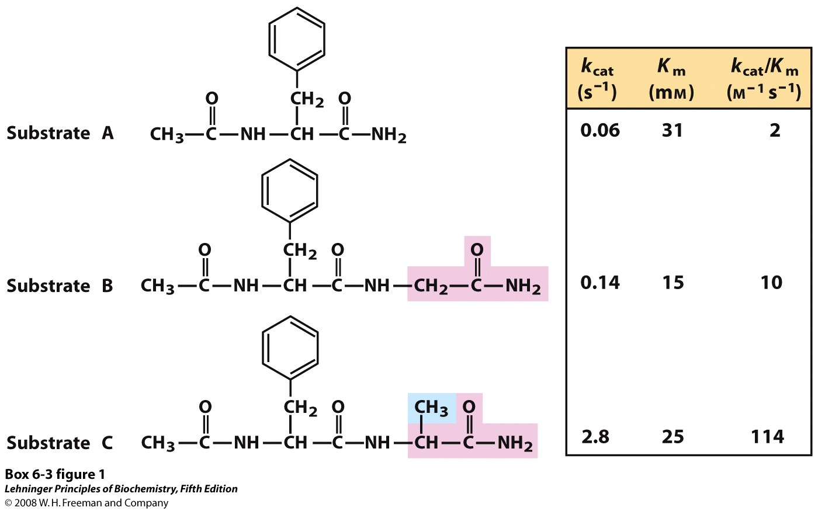
Notes:
BOX 6-3 FIGURE 1 Effects of small structural changes in the substrate on kinetic parameters for chymotrypsin-catalyzed amide hydrolysis.

Slide 68
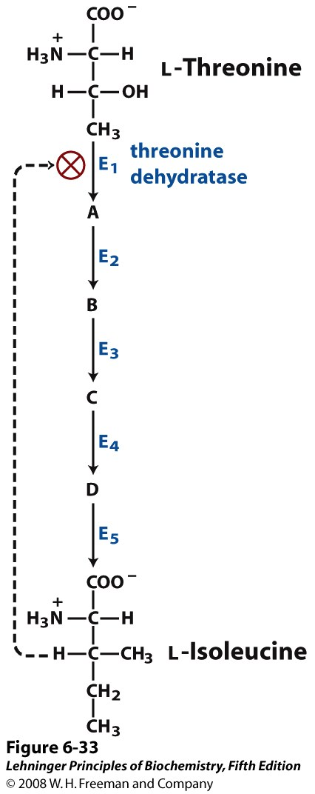
Notes:
FIGURE 6-33 Feedback inhibition. The conversion of L-threonine to L-isoleucine is catalyzed by a sequence of five enzymes (E₁ to E₅). Threonine dehydratase (E₁) is specifically inhibited allosterically by L-isoleucine, the end product of the sequence, but not by any of the four intermediates (A to D). Feedback inhibition is indicated by the dashed feedback line and the ⊗ symbol at the threonine dehydratase reaction arrow, a device used throughout this book.

